Slide 1
Drones for Social Good
Model Drone Regulation Workshop – WEF – June 25th, 2019
UNICEF, Office of Innovation
@unicefinnovate

Slide 2

190 COUNTRIES AND TERRITORIES
70 YEAR OLD ORGANISATION
INVOLVED IN +300 EMERGENCIES EVERY YEAR
LARGEST BUYER OF VACCINES FOR CHILDREN IN THE WORLD
47 MILLION CHILDREN REACHED WITH EDUCATIONAL SUPPLIES
Notes:
About UNICEF
UN agency for children
Works in 190 countries and territories to protect the rights of every child.
Has spent 70 years working to improve the lives of children and their families.
In 2016, UNICEF responded to 344 humanitarian emergencies in 108 countries
45% of the world’s children reached with life saving vaccines
UNICEF works with governments, NGOs and communities to assess needs and procure educational supplies where appropriate.

Slide 3
Big + Complex
Challenges
climate change
emergencies
pandemics
growing youth population
training for tomorrow
UNICEFINNOVATION
@unicefinnovate
Notes:
16,000 preventable child deaths per day
Malaria kills one child every 30 seconds, about 3,000 every day. (20% of the preventable child deaths)
Climate Change
Climate change disproportionately impacts the poorest, deepening existing inequalities. Today, over half a billion children live in extremely high flood occurrence zones; nearly 160 million live in high or extremely high drought severity zones.
Emergencies
More and more, we are faced with increasingly complex humanitarian crises which place the most vulnerable children and women at significant risk.
Pandemics
The increasing trend for international travel and population mobility have led to increased global interconnectivity and along with that the risk of global pandemics:
Growing Youth Population
There are ~ 2 billion young people in the world today (<15y.o.) – 26% of world population / under 25 is 42% of world population, nearly 90% in low and middle income countries - the largest cohort ever.
Yet for many, opportunities are lacking. With only 30% of the world’s poorest children attending secondary school and over 50 million young people on the move a vital window of opportunity to build skills is being missed.
Training for Tomorrow
It is estimated that 65 percent of children entering primary schools today will ultimately work in new job types and functions that currently don’t exist.

Slide 4
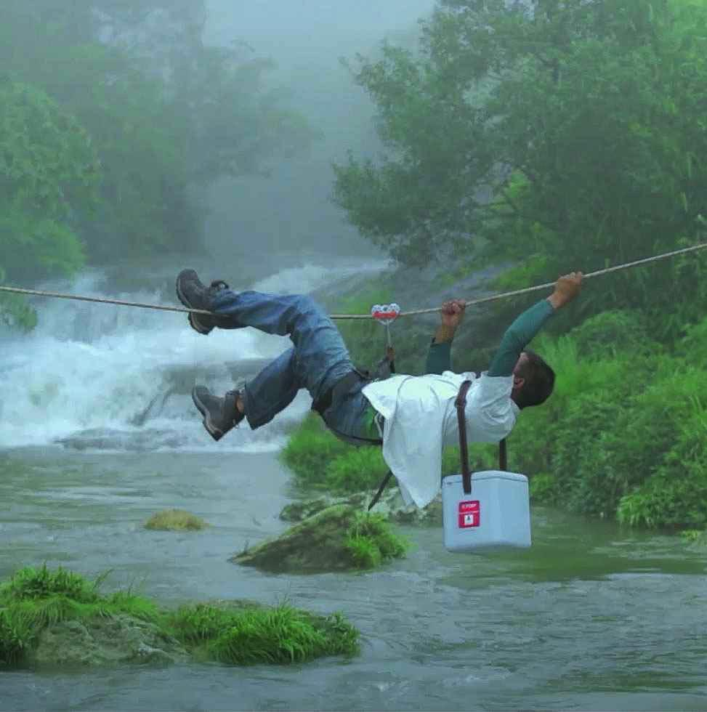
The need
1bn | people live 2km or more from an accessible road
For every child
Reaching the hardest to reach
Respond to emergencies
50% | of the world’s children rely on vaccines from UNICEF
20m | children do not receive vaccines because they live in remote areas
300+ | emergencies responded by UNICEF each year
@unicefinnovate
© UNICEF/UN0259819/Chute
Notes:
The Need: Reaching the Unreachable and Improving Resiliency
One billion people, almost 15 percent of the total human population, live in rural areas more than 2 kilometers away from a paved road. For those who live in these conditions, essential services are often unreliable: Life-saving medical supplies and health posts are scarce, electricity and connectivity are erratic or inexistent. If critical services like these are needed, families and young ones would have to travel through rough terrains, cross turbulent rivers or spend hours until they get the care and attention they require.
This lack of accessibility makes UNICEF’s work more challenging. As the largest single procurer of vaccines, UNICEF purchases one third of the global vaccines supply and delivers immunizations to nearly half of the world’s children. By protecting children against serious diseases, vaccines play a central role in ending preventable child deaths. Vaccines are often delivered from distribution centers to consumers in remote areas, making use of the existing transportation network. Yet every year nearly 20 million children do not receive this indispensable protection. These children live in the most remote areas of the world, also called 'the last mile'. UNICEF is dedicated to identifying those children that have been left behind by the health system and can bring other life-saving care to these mothers and children.
Likewise, the total natural disasters reported each year more than doubled in recent decades, growing from an average of 165 natural disasters reported worldwide per year in the 80s to an average of 333 in the last decade. Every year, major earthquakes, hurricanes, floods, droughts, landslides and other extreme weather conditions generate billions of dollars in losses and affect hundreds of thousands of people. Children are typically half of all people affected by disasters and are especially vulnerable to threats of malnutrition, disease, violence and trauma. These threats are especially prone to children living in high risk locations— like floodplains, river banks, steep slopes, reclaimed land— or in geographically and socially marginalized populations.
On average, of the 300+ emergencies that UNICEF responds to, more than 200 emergencies are caused by natural hazards each year. UNICEF informs and shapes these interventions as a global leader for children. As the only UN agency with a primary mandate for children, UNICEF is committed to ensure that humanitarian responders meet the basic needs and uphold the rights of children and women. In such situations, it is vital to quickly assess where vulnerable children and families are, so that we can quickly and effectively respond to their needs . As hazards steadily increase, UNICEF needs more effective tools— like drones— to help governments and communities identify, assess and reduce risks associated with natural phenomena.

Slide 5
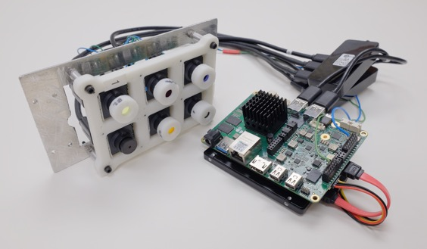
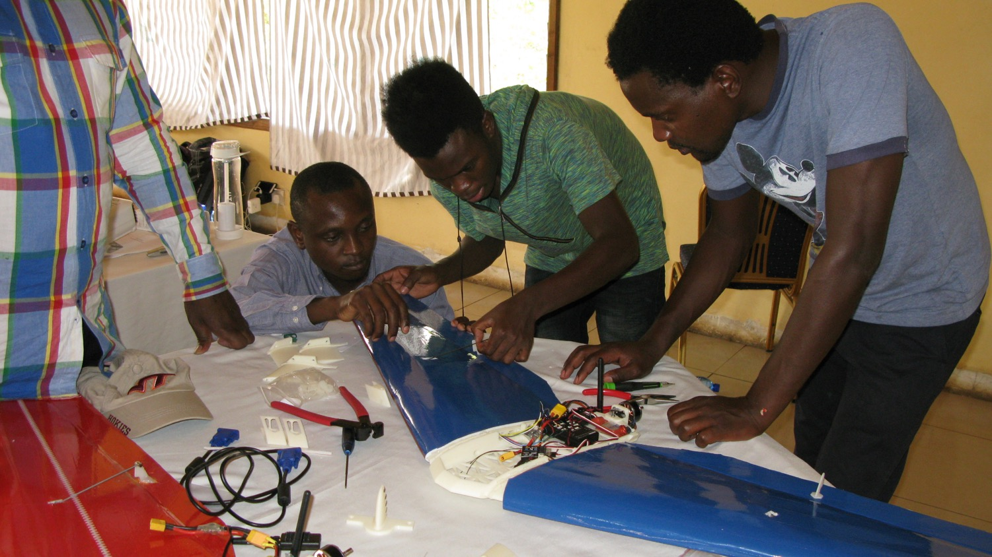
Confluence of 3 cross-cutting technologies:
Machine learning
+
Aircraft
+
Imaging & other payloads
UNICEFINNOVATION
@unicefinnovate
Notes:
Machine learning: Making sense of the data. Algorithms get trained to recognize certain features in pictures through the use of “classifiers” and applies this logic to new pictures.
Aircraft: Rugged, reliable, repairable. Must survive conditions that are: Dusty, Muddy, Torrential rain, Humid, Hot , High altitude
Imaging payloads and capacity to carry other payloads: The information is there, we just need to extract it.

Slide 6
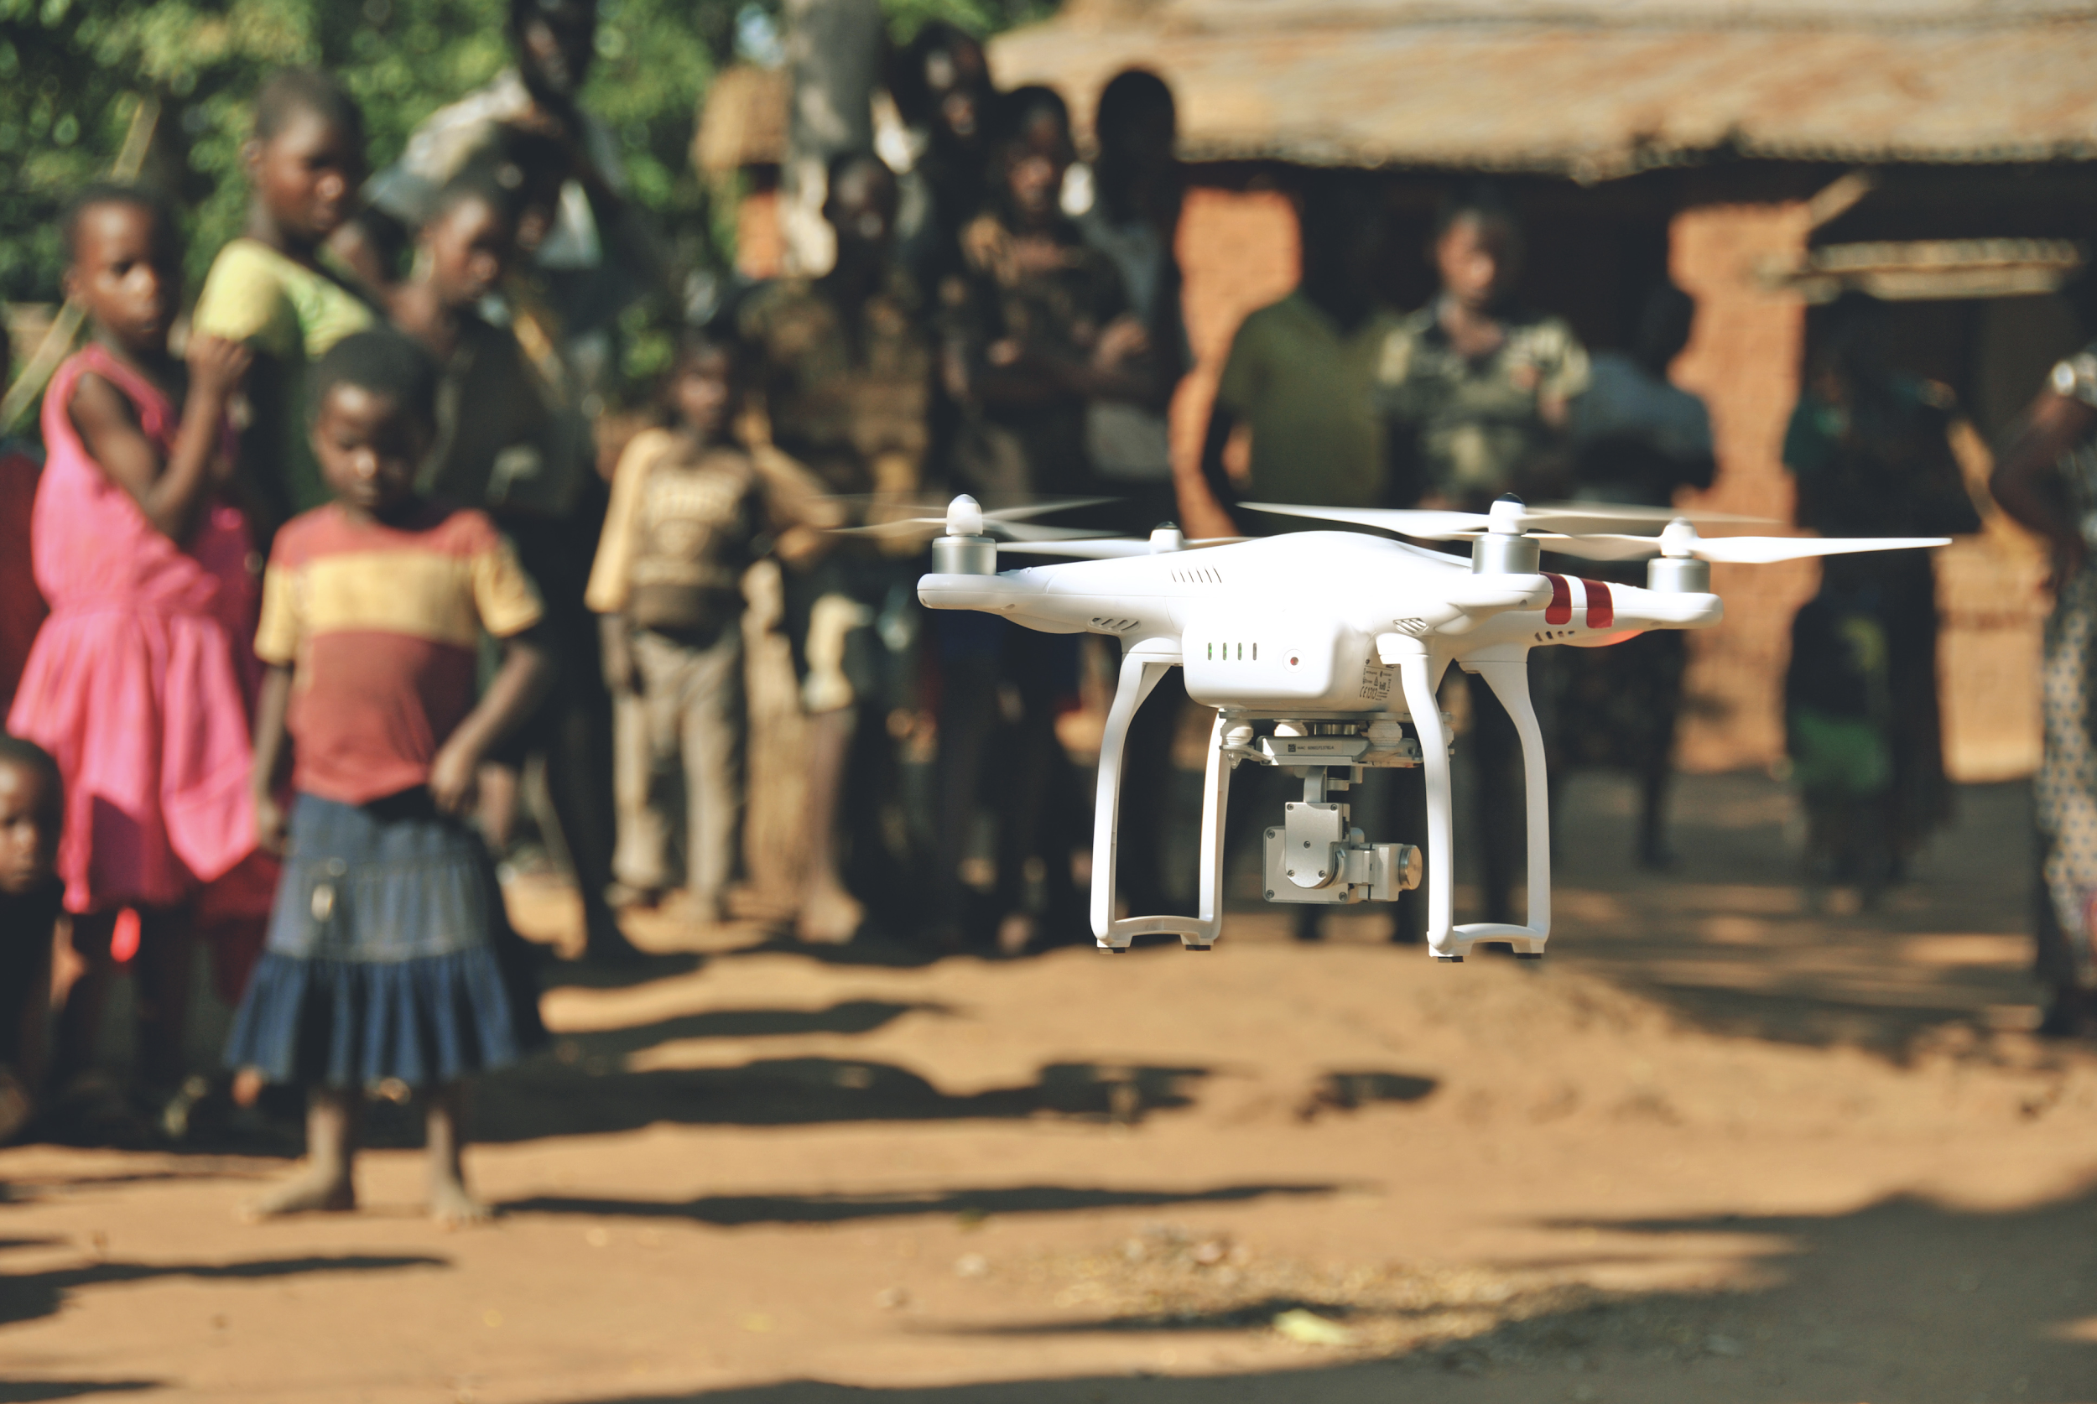
How can Unmanned Aircraft Systems (UAS) help us?
Imagery
Transport
Connectivity​
UNICEFINNOVATION
@unicefinnovate

Slide 7
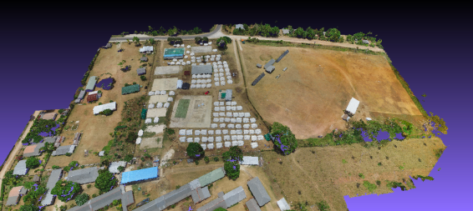
Imagery
Drones imagery and AI are helping to strengthen resilience to hazards by helping map out disease outbreaks like cholera; identifying areas at risk of flooding, mudslides or other natural disasters; or assisting in search and rescue operations during emergencies.
@unicefinnovate
Notes:
Drones are an effective tool to collect high-resolution aerial imagery or video for situational awareness during emergencies. This helps UNICEF and emergency responders with carrying out risk analysis and/or damage assessments during natural disasters. Drones also improve disaster risk reduction efforts, as they provide low-altitude, high-resolution, fast, relatively low-cost photography and video. With this aerial imagery, UNICEF works with local communities to assess risks and, in collaboration with partners, develops algorithms that help prevent natural disasters.

Slide 8
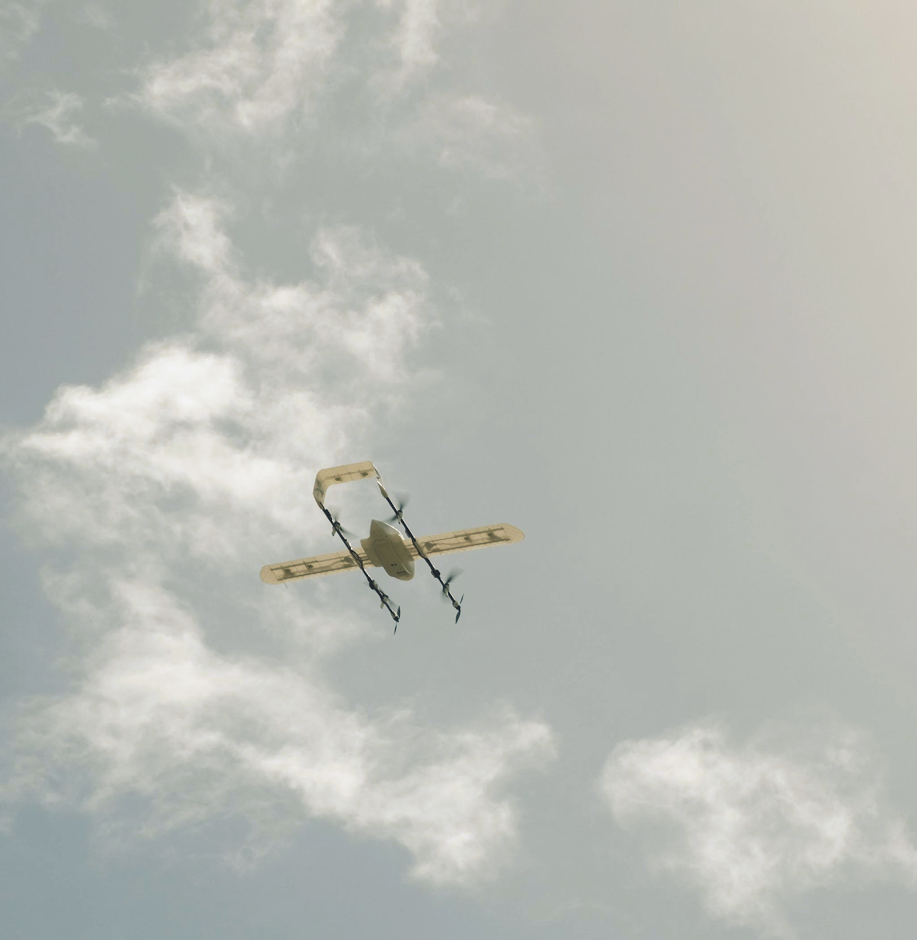
Transport
Drones are delivering life-saving medical supplies, in a matter of minutes, to children in hard-to-reach communities.
@unicefinnovate
Notes:
Drones create efficiencies to help save lives in remote areas while potentially enhancing the entire humanitarian supply chain. For example, drones can help deliver vital medical supplies and other perishable goods—like vaccines and medicines—in a matter of minutes, while maintaining the cold chain, for people living without access to medical posts.

Slide 9
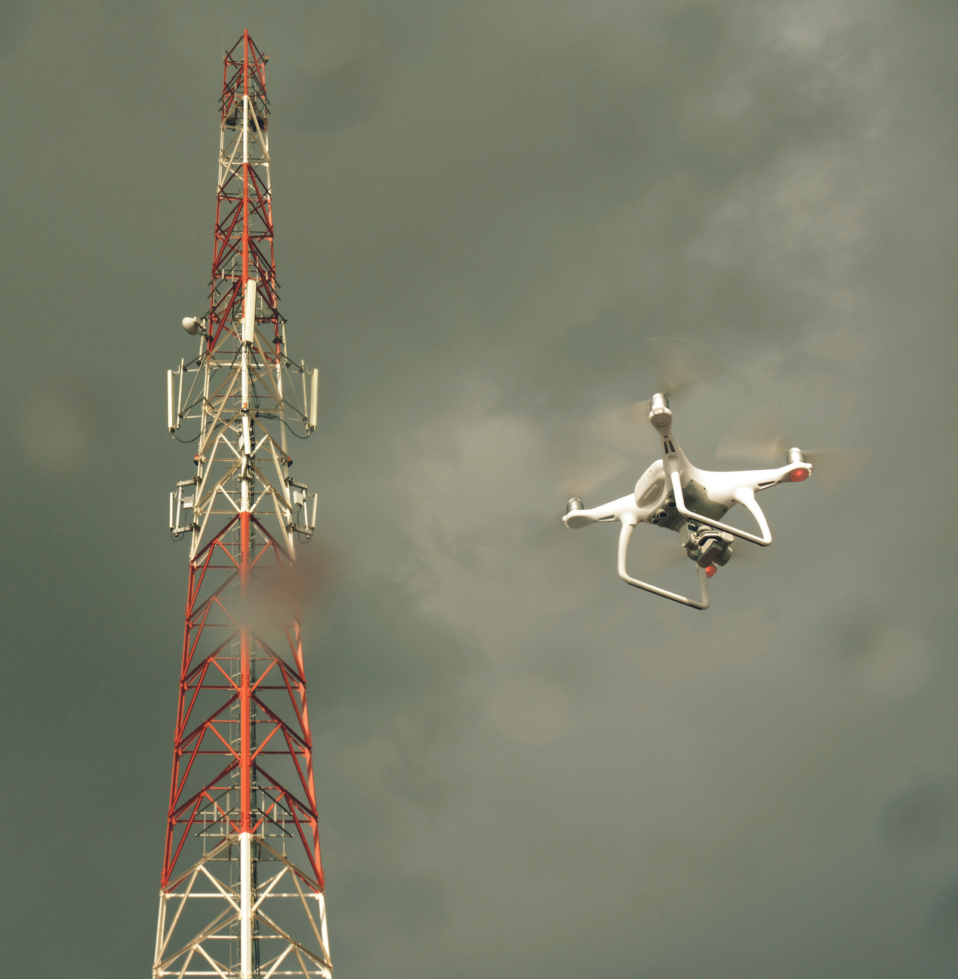
Connectivity
Providing connectivity to close the information divide that affects the most vulnerable communities and to assist emergency responders.
@unicefinnovate
Notes:
Connectivity can be a vital resource for preventing the spread of a health epidemic or promoting children’s education. Yet, in many of the places where UNICEF works children and families do not have access to this important resource. Easily deployable technology solutions—such as tethered drones or high-altitude long endurance drones—can provide connectivity to such areas and help close the information divide adversely affecting disconnected communities and emergency responders.

Slide 10







Helping governments learn and learning with them:
Malawi
Vanuatu
Kazakhstan
GOVERNMENTS
PRIVATE SECTOR
+
ACADEMIA
CHILDREN
@unicefinnovate
Notes:
We help governments learn, and learn together with them, how new technologies and services can help strengthen their systems to deliver health, education, and opportunities to children.
We serve as a convening force across the United Nations system and among international organizations, to co-create and implement solutions for children.
We partner with the private sector, research institutions, and local entrepreneurs in new ways, demonstrating how doing good is good business. This often means looking beyond philanthropy and working with businesses to deliver for children while identifying and meeting market needs.
To:
Provide life saving info and services to children
Engage young people in change
Help UNICEF meet children’s needs today and tomorrow

Slide 11
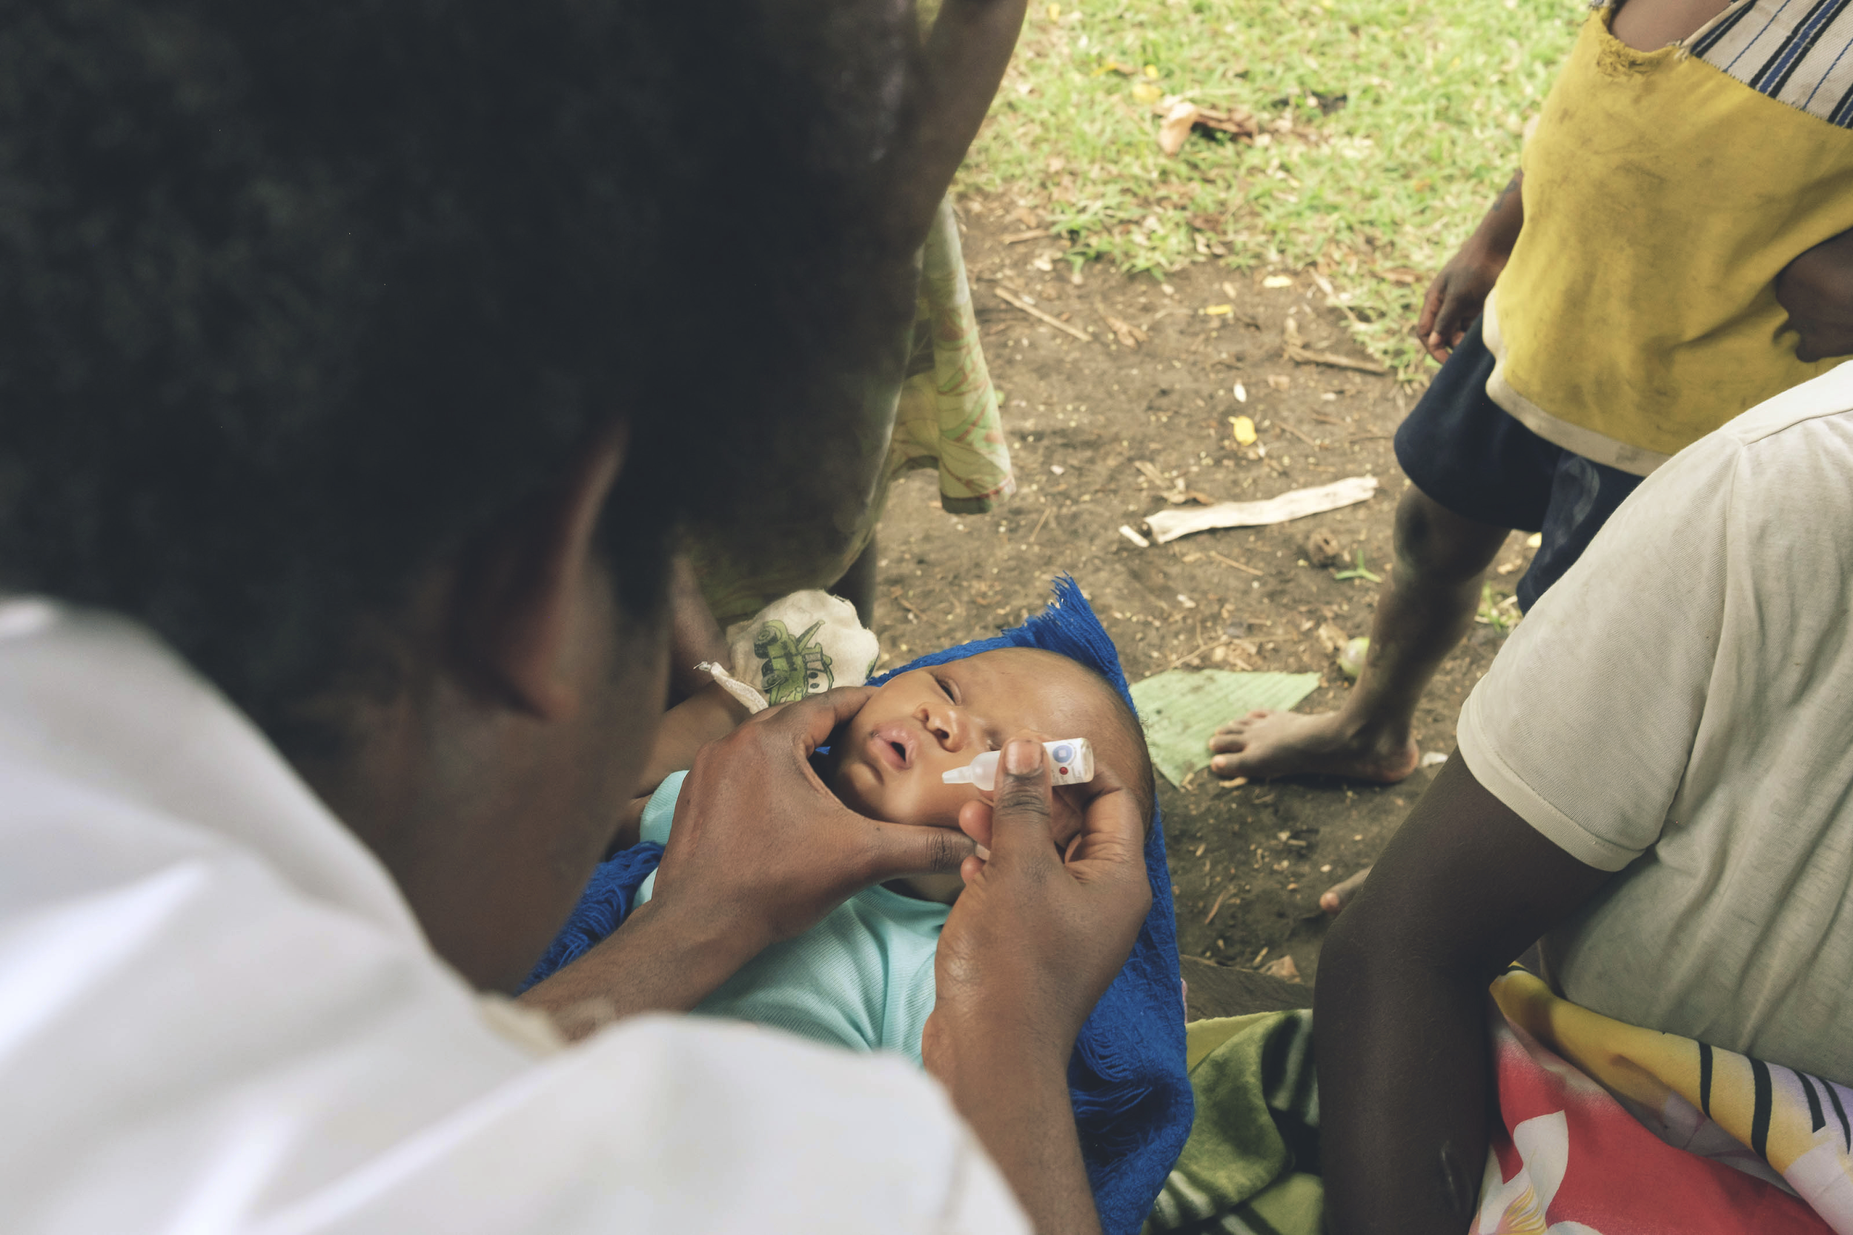
Key considerations:
1) Build local capacity
2) Support national policies & public-private partnerships
3) Operate with limited infrastructure
UNICEFINNOVATION
@unicefinnovate
Notes:
Building local capacity: In order to ensure long term sustainability to using drones in a country, UNICEF will need to either harbor or develop skills locally—especially in operating and maintaining drones. Aside from developing local talent, the fixed cost for operating and servicing drones could be reduced by over 30% if service providers are sourced locally.
Supporting national policies & public-private partnerships: While governments and regulatory bodies are working to implement regulations and protocols to safely integrate drones into their airspace, UNICEF can advise on best practices to ensure the safety and equity of the most vulnerable children are included in such regulations. Through its substantive networks with private sector partners, civil society, and global organizations, UNICEF could also provide insight to sustainable public-private partnerships for developing a safe drones ecosystem in its countries of operation.
Operating with limited infrastructure: During emergencies, having the right infrastructure and expertise in place to use drones is paramount. The ability to assess infrastructure gaps; identify and validate vendors available to provide services within the 24-72 hours; and access to the necessary tools “in the right place at the right time” for managing big data processing and analytics locally is crucial.

Slide 12
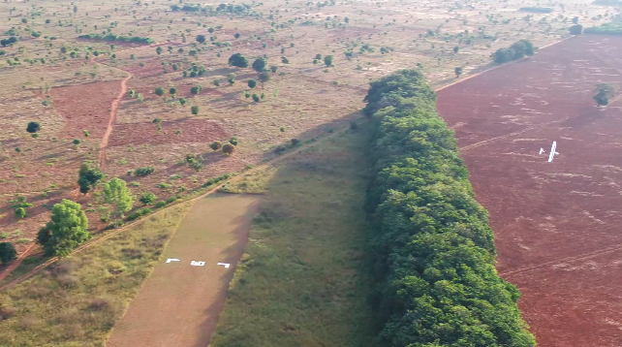
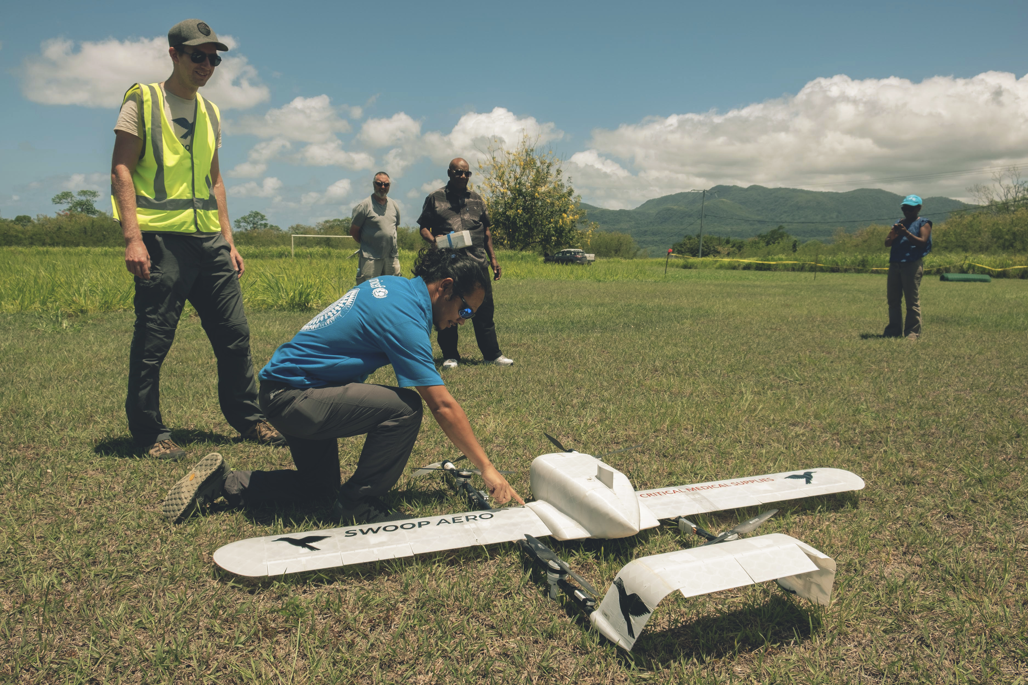
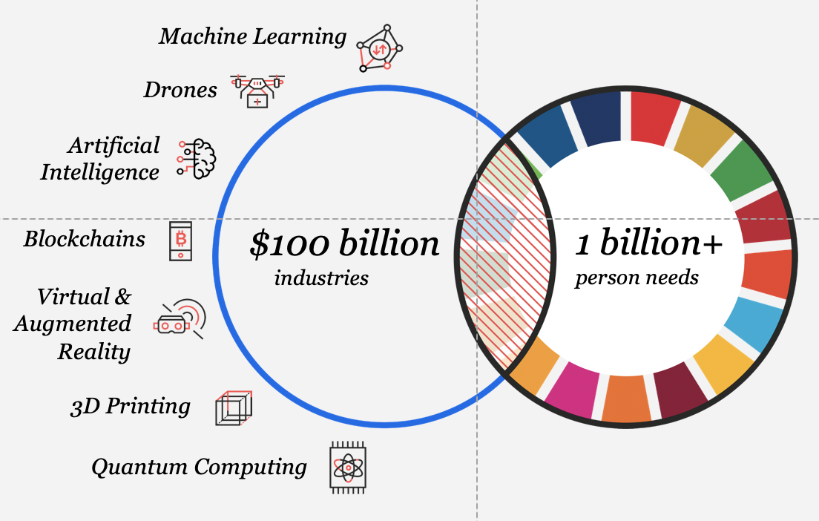
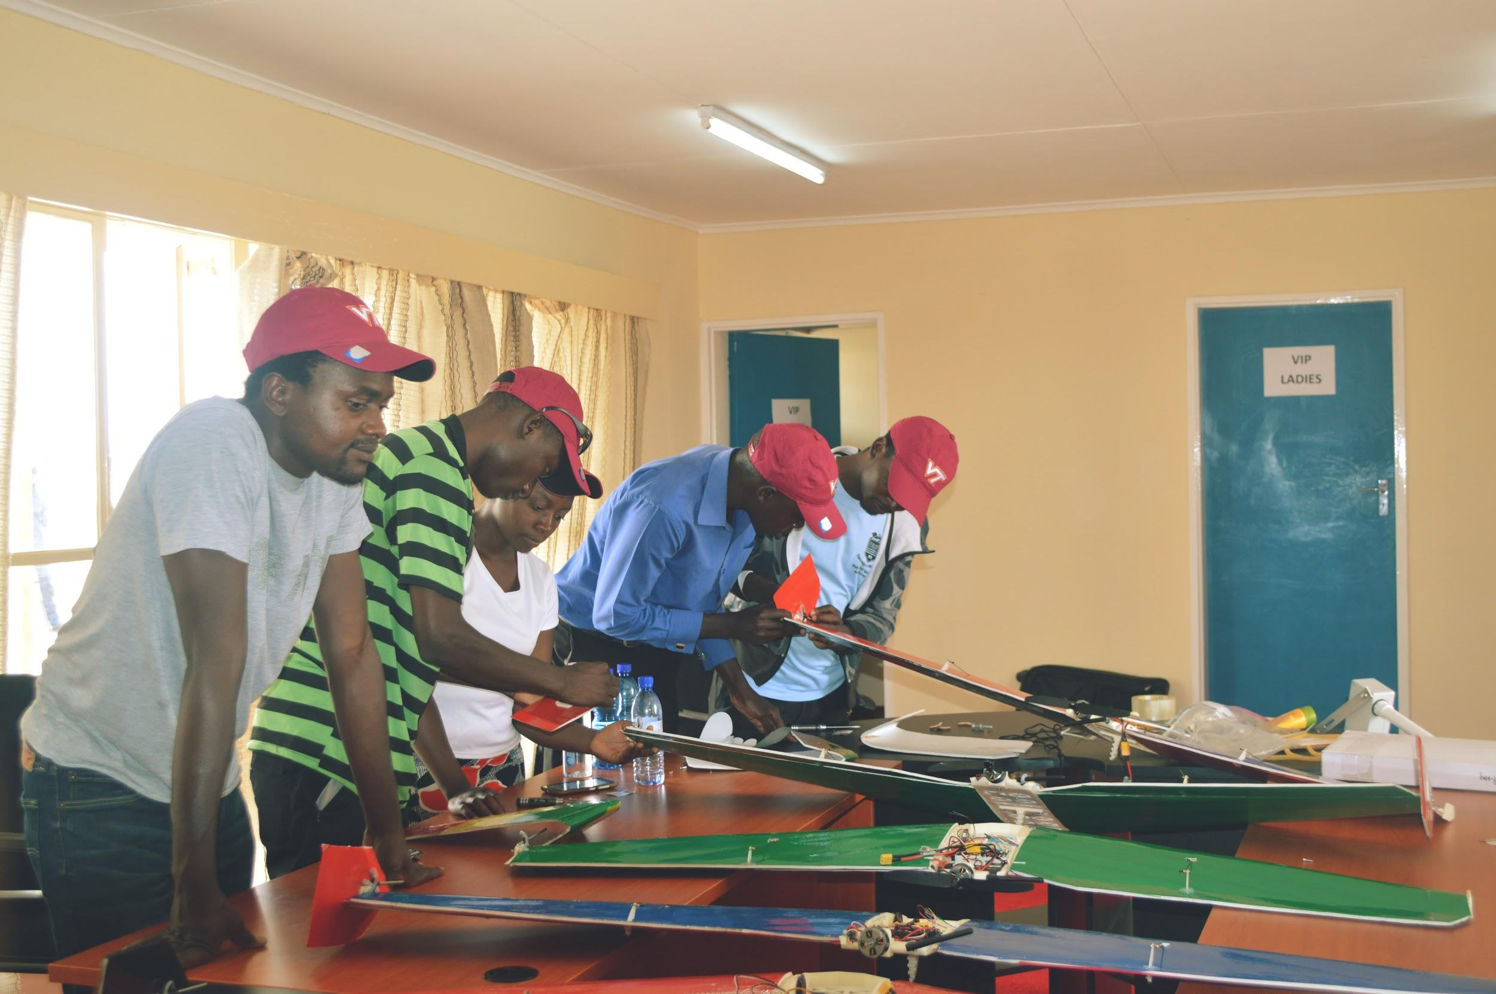
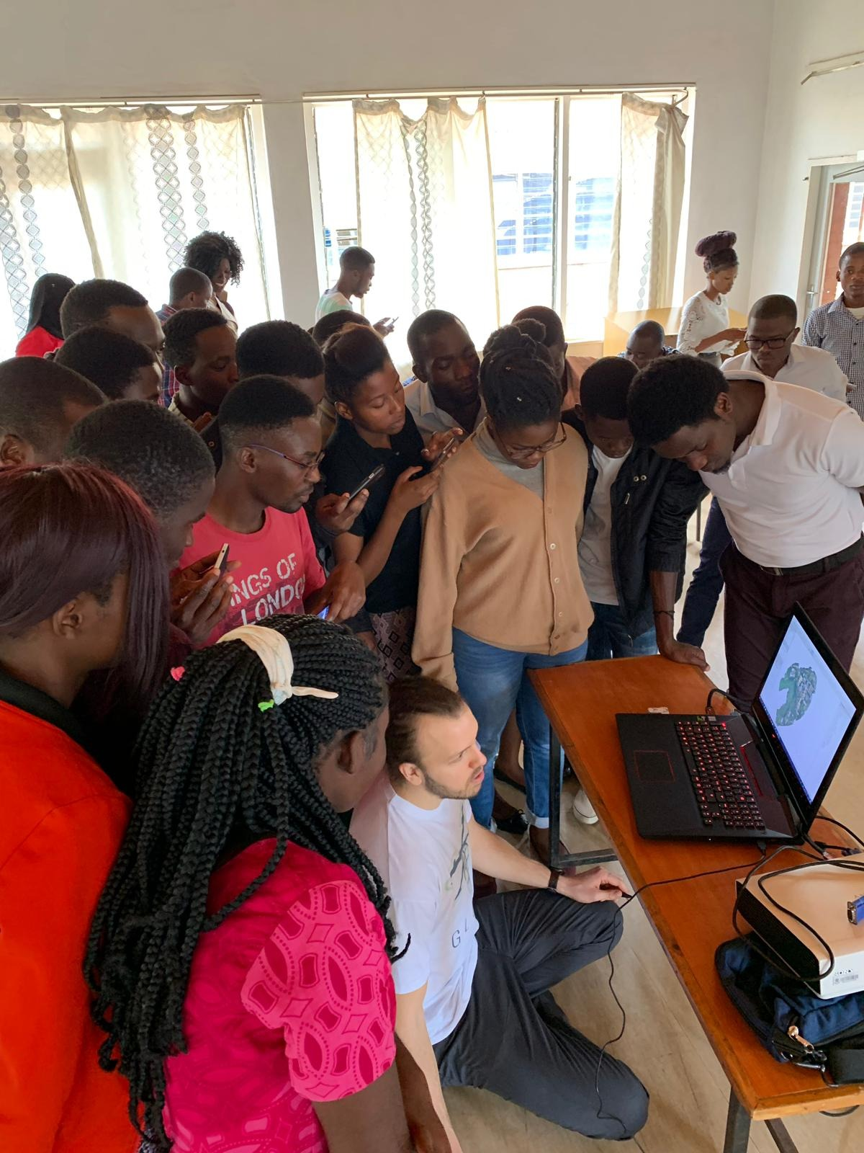
CREATE A LOCAL ECOSYSTEM FOR DRONE TECHNOLOGY AND SERVICES
DRONE CORRIDORS
TRIALS
UNICEF VENTURE FUND
DELIVERS RESULTS FOR CHILDREN
BUILD SKILLS AMONG LOCAL YOUTH
@unicefinnovate
Notes:
UNICEF drone corridors have provided an added value to country programs using drones for good. Corridors have an accelerator effect for the early test and adoption of diverse drone use cases. As corridors are a regulatory sandbox, where flying BVLOS is allowed, they help UNICEF country offices and host governments to develop partnerships with academic and research institutions, drone manufacturers, companies willing to test their drone-based services, among other players.
The corridors create opportunities for knowledge transfer through workshops and learning opportunities organized by UNICEF country offices and partners, where young students discover the applications of drones for good. Corridors are also important to raise awareness on the use of drones for social good, and to create a favorable public perception around this technology. In summary, the corridors constitute a building block for the emergence of a local ecosystem for drones to deliver good for children; as they provide a safe space for governments to learn and test the technology in different circumstances.
UNICEF’s Venture fund provides up to $100 k USD in equity-free investment to drone startups. It supports local innovation. We’ll be announcing the next cohort, 7 startups that we’ll be funding, they are working in the development of new low-cost UAVs for transport of medical supplies, algorithms to make use of drone acquired imagery, UTMs, among others.
49 companies sent us their Expressions of interest (EOI) // Invited 30 to submit a request for proposal (RFP) // 19 submitted a RFP → we’ll be funding 7 companies.

Slide 13
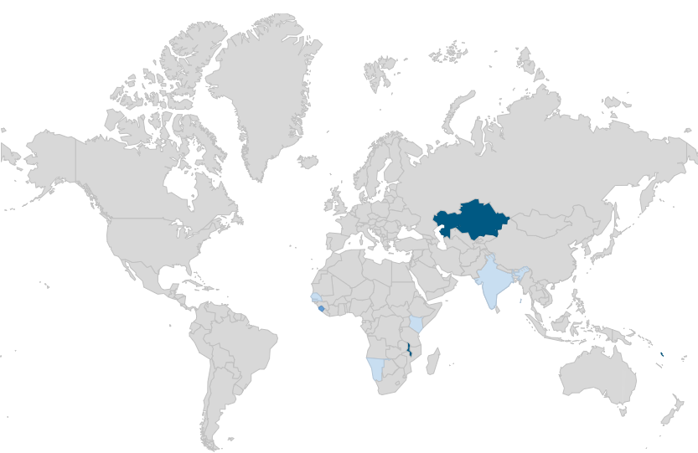
Establishing the highest and first humanitarian drone corridors
TO UPDATE:
Export map from Drones spreadsheet
https://docs.google.com/spreadsheets/d/1_HaXB64rud7jsnnmNteUXClGpqZ245RLlyUSynAd-Oo/edit?usp=sharing
[soon] IRELAND
Technical Collaboration
KAZAKHSTAN drone corridors
Search and rescue, training, emergency response; 5,000 sq. km, 5,000m AGL (highest corridor)
[soon] SIERRA LEONE
Imagery and emergencies
[soon] INDIA
Vaccine delivery
MALAWI drone corridor
World’s first drone corridor for humanitarian cases; >5,000 sq. km (largest corridor), 400m AGL
[soon] NAMIBIA
Drone delivery network
VANUATU
Vaccine delivery; first baby vaccinated from drone delivery
Notes:
Malawi - Using drones to help prevent floods, malaria and cholera.
In collaboration with the government, a 45 km-radius drone test corridor was launched on 29 June 2017 - the world largest humanitarian drone testing site.
The aim for this space is to test the safe integration of drones for imagery, connectivity, transport; and for companies and academic institutions to engage in community outreach and capacity building activities, while they use the corridor for testing their technologies.
More than 15 companies, universities and research centers, from all over the world, have participated in Malawi’s corridor to test their drones technology and services.
These organizations have collected aerial images that are being used to train algorithms that help identify infrastructure (e.g. schools, clinics, water sources), prevent natural disasters (floods and mudslides) and diseases (malaria and cholera), improve crop yield and water management for farmers, among others.
Globhe and Flypulse, two Swedish drone startups, have accomplished multi-purpose drone flights covering a distance of over 66 km; being able to deliver medical cargo into hard to reach areas and capturing images that automatically trigger insights --such as road quality, flooding and number of households in the area.
Lancaster University, the Liverpool School of Tropical Medicine and Globhe have used drones to collect data that helps identify mosquito breeding sites. Applying artificial intelligence and image recognition, this data is compared to water samples collected in Kasungu; and then used to train algorithms that help predict which areas are prone for mosquito breeding, so that larvae can be controlled, reducing the number of adult mosquitoes able to spread malaria.
Globhe tested the ability of IBM’s Watson super-computer to analyze drone acquired images from the drone testing corridor. The results were impressive: at the first run, Watson was able to identify houses, schools, latrines and water pumps with an accuracy of 90% from the pictures taken with a Ground Sampling Distance of 5 cm per pixel.
The University of Kyoto researched the applicability of consumer drones for monitoring crop production, vegetation and market accessibility of subsistence farmers in Malawi.
UNICEF Malawi used drones to collect aerial images from Area 24 --a crowded township in Lilongwe. The images were printed to form big maps, where the community helped identify open and contaminated water sources, as well as sanitation and hygiene problems. This information helped the water and sanitation teams to plan the cholera outbreak response and prevent further contagion.
The first UTM System on the African continent was successfully established in the Malawi drone testing corridor in March 2018 with the help of Unifly and uAvionix.
The companies and universities who used the corridor, have also conducted drone workshops to benefit over a 100 young Malawian technologists and students.
Globhe and the University of Kyoto have introduced students from the Lilongwe University of Agriculture and Natural Resources to drone technology, GIS and use of drone-acquired imagery.
Virginia Tech led a three-day workshop that gave Malawian students a quick-start experience in drone construction and component integration, which culminated in the building of low-cost drones and flight testing in Kasungu.
Vanuatu - Temperature-controlled cargo delivery
In collaboration with the government, UNICEF helped launch an international competitive procurement process for the delivery of vaccines.
Vanuatu provides a useful experience for other governments in similar settings; as drone-delivery service providers are selected after a competitive bidding process, awarded with contracts only after they have shown the capacity to do the job, and held accountable if they do not deliver.
This experience presents also a unique opportunity for industry to test and develop the full logistics around rolling out unmanned capabilities for transport, including testing the safe integration of this technology in non-segregated airspace.
A total of 20 bids from drone companies within the Pacific region and from countries around the world were received and evaluated.
In a world first, the Government of Vanuatu awarded 3 commercial contracts to 2 drone companies: Swoop Aero Pty Ltd of Melbourne, Australia, and Wingcopter Holding GmbH & Co. KG of Darmstadt, Germany.
These companies have designed and implemented Logistics and Operating Procedures (LOP) for vaccine supply chain by drone in Vanuatu, as well as provided training to the local health workers that receive the vaccines at rural facilities.
On December 18 2018, one month old Joy Nowai became the world’s first child to be given a vaccine delivered commercially by drone.
Until April 2019, the companies will continue delivering vaccines from 7 distribution centers to 48 rural health facilities in Vanuatu’s Pentecost, Epi, Shepperd and Erromango islands.
The vaccines will benefit more than 1,100 children under 1 year old.
Kazakhstan - Using drones to save lives in search and rescue operations
Kazakhstan, a large country with diverse terrain, is vulnerable to nearly every type of natural disaster: floods, extreme temperature events, earthquakes, landslides, mudslides, storms and wildfires. Every year, close to 4,000 emergencies cause 3,000-5,000 injuries and claim several dozen lives. The changing climate also affects the rise of weather-related disasters.
In collaboration with the government, UNICEF established two drone corridors in the country to create a Central Asian implementation hub.
This hub focuses on applications of drone technologies and services in emergencies, such as avalanche or earthquake search & rescue, and in their use as preventive tools for identifying risks in time.
Kazakhstan and Central Asian drone companies have tested their technology in this corridor for search and rescue operations, wildfire response, and mountain mapping.
UNICEF Kazakhstan, in collaboration with Kazakhstan’s Center for Emergency Situations and Disaster Risk Reduction, conducted a training seminar on how to use drones for emergency response. Forty-two participants from emergency response agencies of Kazakhstan and neighboring Central Asian countries --Kyrgyzstan, Tajikistan, Turkmenistan, Uzbekistan and Afghanistan-- participated in this event.

Slide 14
Malawi

Slide 15

Malawi
Foto by: Mark Fischer
Population >18 million
Malnutrition: 46% stunting
Floods cause hundreds of deaths each year & tens of thousands displacements
Health:
Malaria, cholera and diarrhoea major causes of death among children
30,000 newborn HIV infections per year
Lack of infrastructure: 11 days to get HIV blood samples to laboratory and up to 4 weeks for results
UNICEFINNOVATION
@unicefinnovate
Notes:
A series of stores in the Waterside Market section of Monrovia, Liberia.

Slide 16
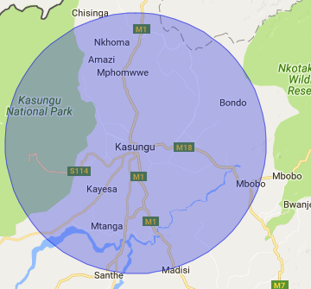

Malawi Test Corridor
World’s largest humanitarian test area: 40 km radius around Kasungu airfield, >5,000 sq km + operations up to 400 m above ground level.
Ideal to test communication links, flyby packet drops (BVLOS), aerial imagery.
Covers majority of population in Kasungu District (480,700 people), 60 + villages within radius, > 300 schools, health centers, clinics.
40 km
UNICEFINNOVATION
@unicefinnovate

Slide 17
Malawi
Technical Guidance of Operations for RPAs in Malawi Airspace
Commercial operations;
Corporate operations;
Non-profit operations;
Private operations
United States - FAA Part 107
+ Malawi context
South Africa - SACAA
Part 101
UNICEF drone corridor
2017
2019
UNICEFINNOVATION
@unicefinnovate

Slide 18
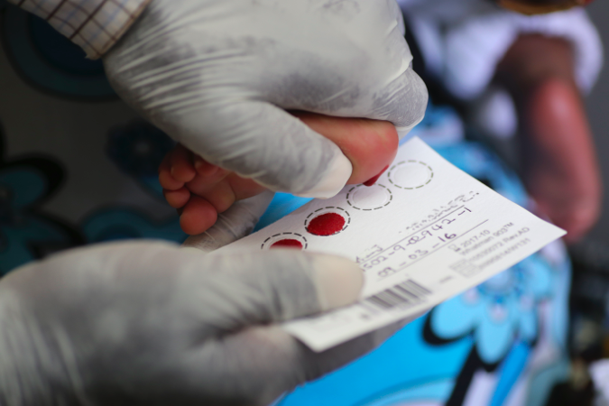
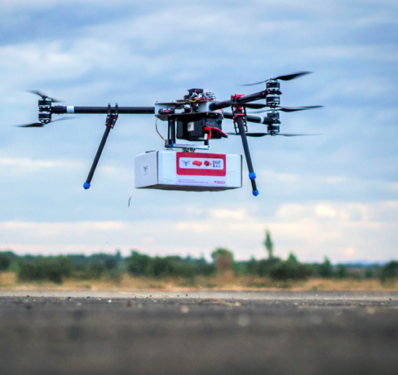
Transport proof of concept
Dried blood spot (DBS) sample from 6 week old baby, at Matapila Health Centre, in Lilongwe, Malawi.
UAS speed up delivery of HIV tests
UNICEFINNOVATION
@unicefinnovate
Notes:
The time taken to get from healthcare facility to the lab is 11 days, and time taken to return the results by road can take as long as 8 weeks.
URGENT Blood immunization material, Stock ressuply, speed up treatments
1 billion + persons needs with 100 billion dollar industries = PHARMA

Slide 19
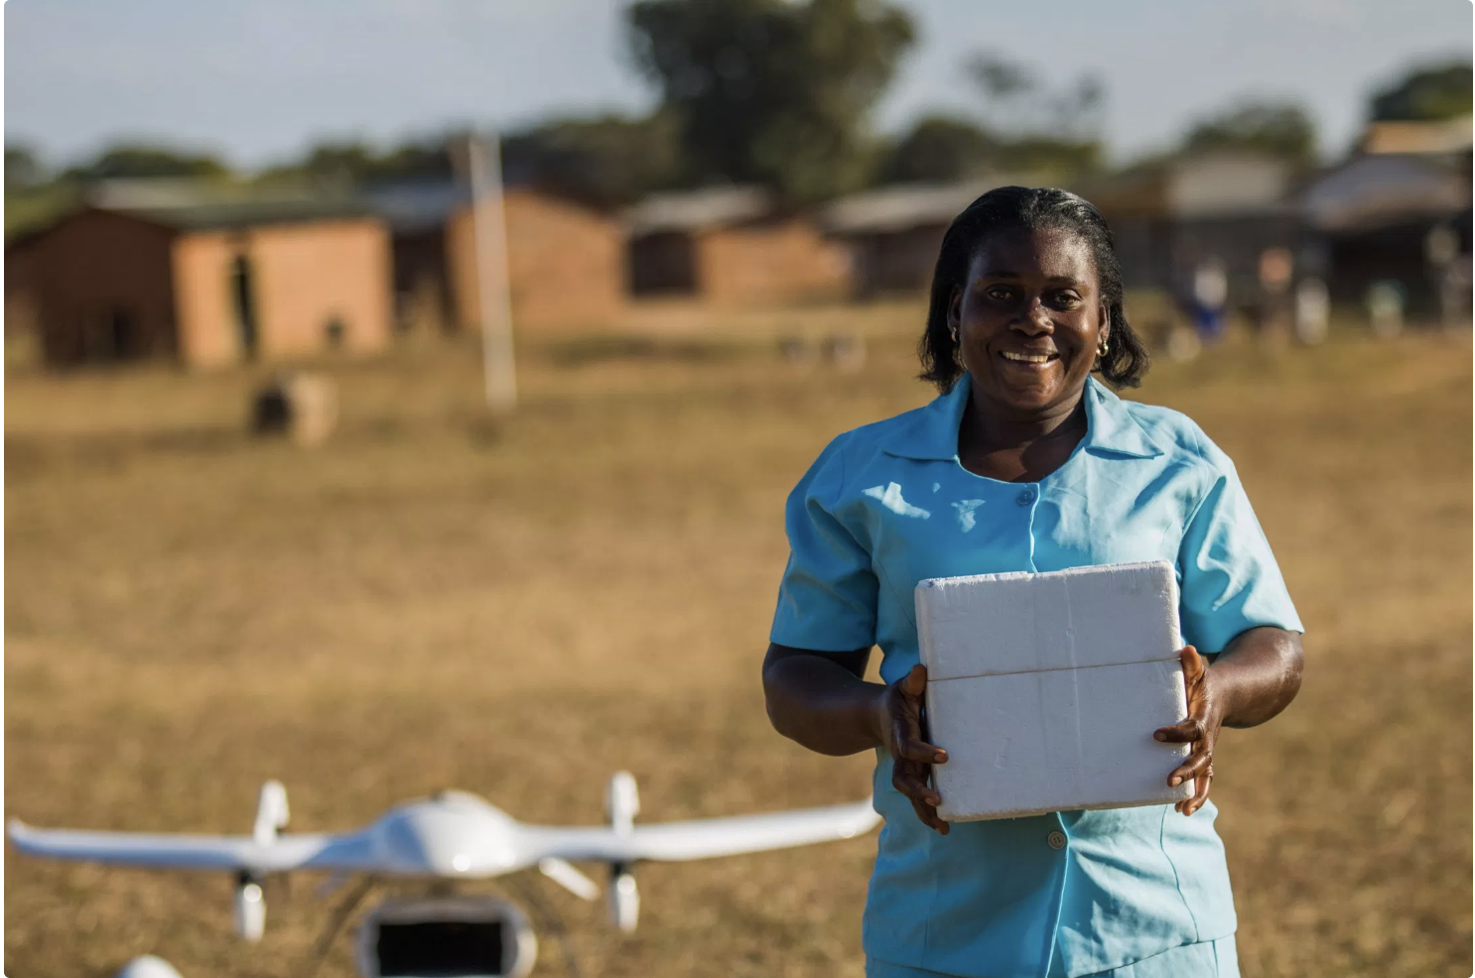
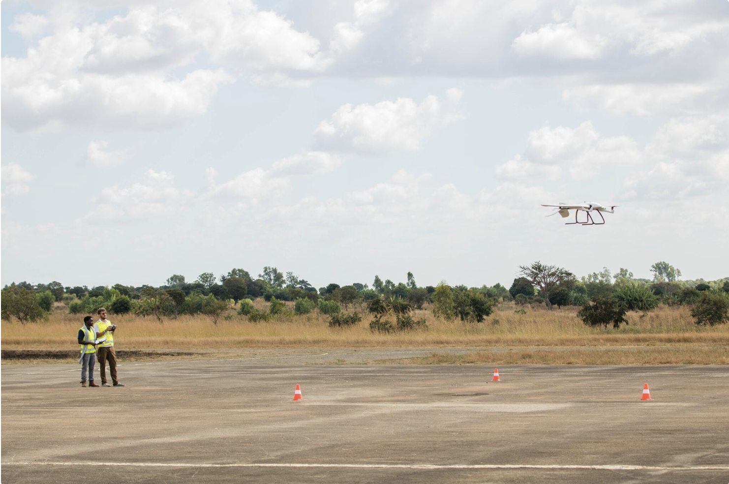
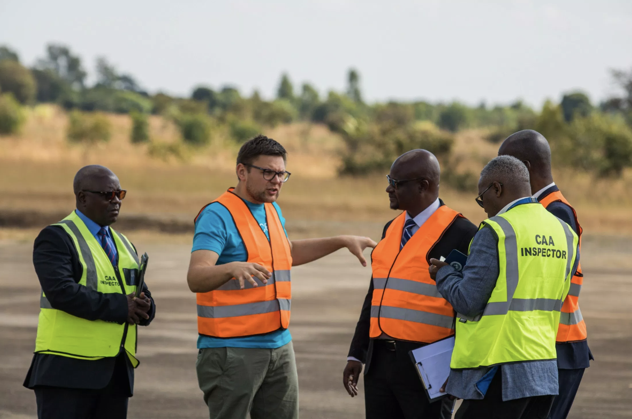
Test flights for CAA approval
Drone test flights: From Kasungu corridor to Lifupa health center (longest bi-directional flight: 76 km).
Two-way transport of medical supplies
UNICEFINNOVATION
@unicefinnovate
Notes:
USAID-Chemonics + UNICEF
Test flights in Kasungu corridor to refine safety protocols and show Malawi CAA the SOP for these VTOLs to deliver health supplies.
Kasungu to Lifupa – 55 km flight / Cold chain
Nurses / healthworkers like Elizabeth – integrated from the beginning.
https://unicefmalawi.blog/2019/06/19/utilizing-drones-to-deliver-health-supplies-in-remote-areas/

Slide 20
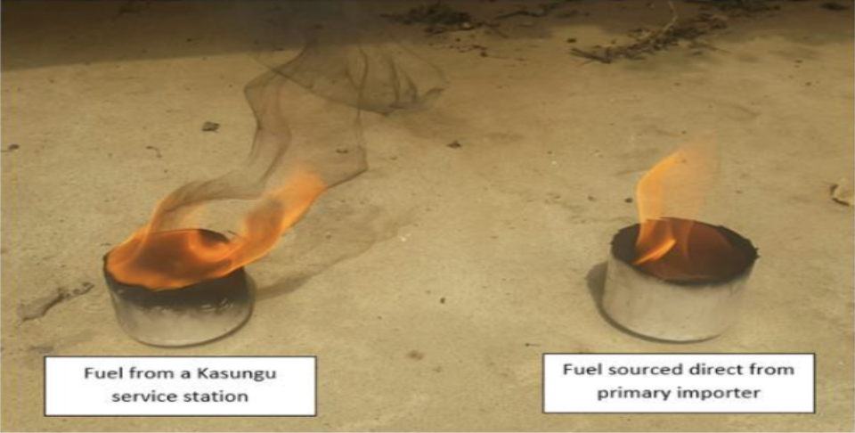
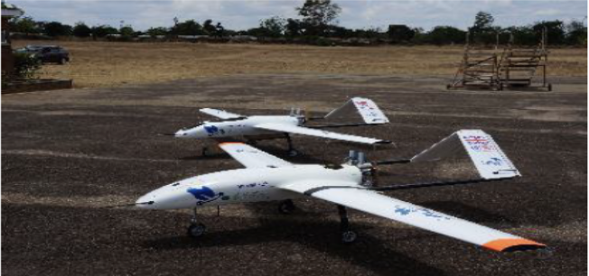
Technical preparation is paramount
Testing humanitarian UAS in the most challenging real-life scenarios
UNICEFINNOVATION
@unicefinnovate
Notes:
Fuel contamination. – Restricted flight operations of this multi-purpose UAS.
Local gasoline contaminated: Chemical, particulate
Manufacturer came up with a solution: Implement a new type of UAS fuel injector (higher contaminant tolerance), source clean fuel within Malawi, ensure handling items are clean, filter all fuel.

Slide 21
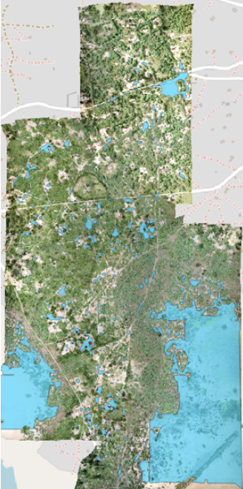
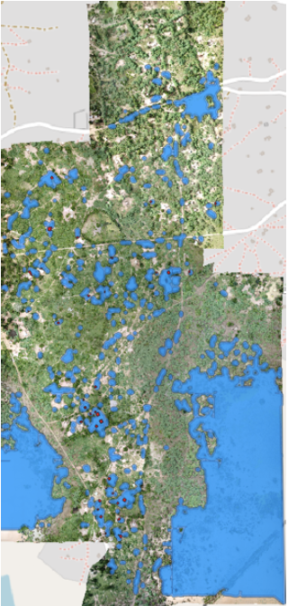
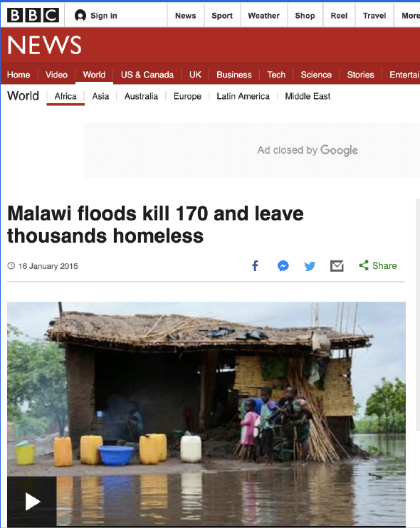
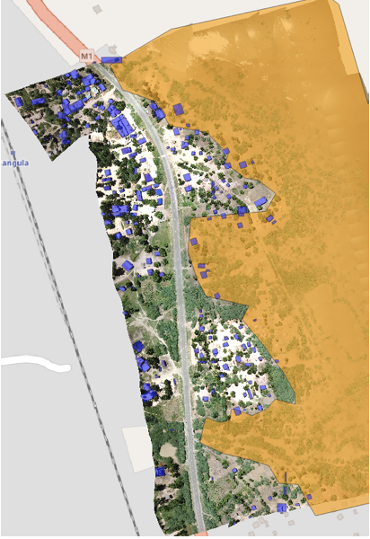
Disaster response
Cyclone Idai – Floods in Nsanje District
UNICEFINNOVATION
@unicefinnovate
Notes:
8 km2, 5:38 hours, 135 km flown, 3.3 cm/px (ground sampling distance), 2 low cost quadcopters with high-res camera, 2 drone pilots, 1 GIS expert, 10 minutes to process per map, 5 minutes analysis per map.
Identified buildings, households and structures affected by current levels of water.
Modelled flooding scenarios: What if water levels expanded by 5 m / by 20 m?
Part of an Inter-Agency Assessment Group: Formed by Red Cross + UNICEF + Department of Disaster Management Affairs

Slide 22
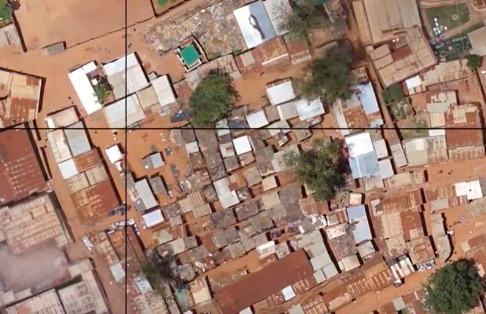
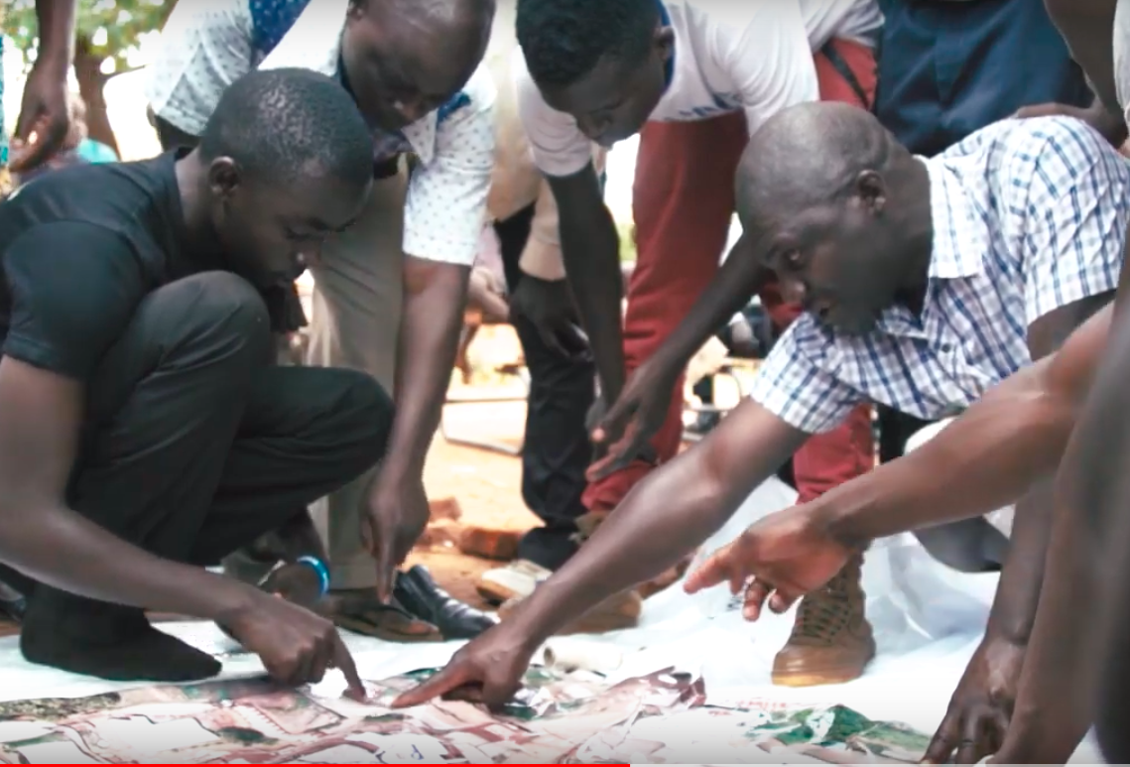
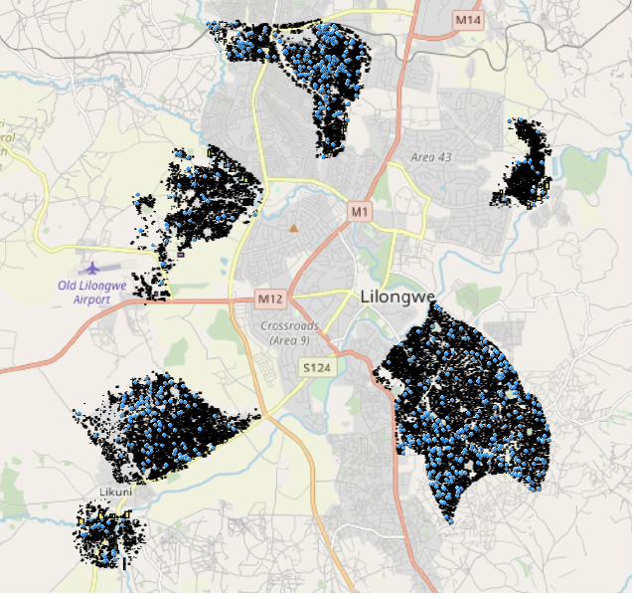
Mapping cholera outbreak
UAS capture aerial imagery from Lilongwe
Ground truth data acquisition: Community identified areas without latrines and possible contaminated water
Trained AI helped id cholera related features and hotspots
UNICEFINNOVATION
@unicefinnovate
Notes:
Malawi Floods: Water resource management – Map water holes that are polluted and those still safe to drink
Contain possible outbreaks of disease (i.e. cholera). Malawi: 11% of population still defecate in the open.
Community sensitization
Drone data acquisition – 2a) Drone data used for community engagement
Ground truth data acquisition by students
AI used to identify cholera related features
Data analysis and id of cholera hotspots

Slide 23
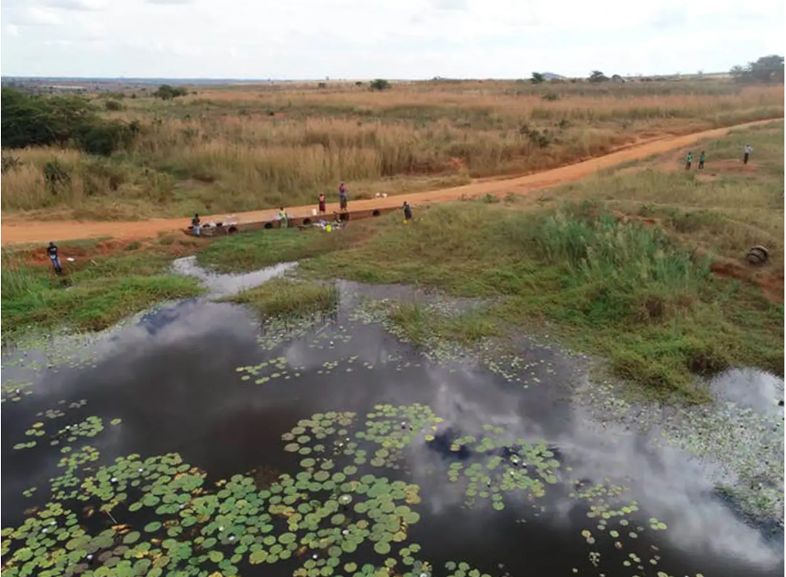
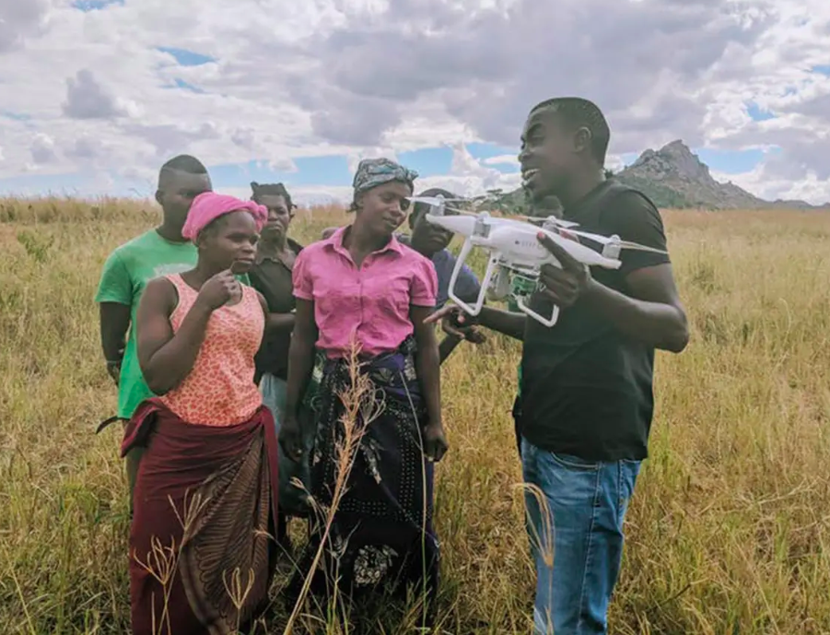
Preventing malaria
UAS capture images from water reservoirs to map mosquito breeding grounds for environmental control
Images are then compared to water samples, to identify other potential breeding sites
UNICEFINNOVATION
@unicefinnovate

Slide 24
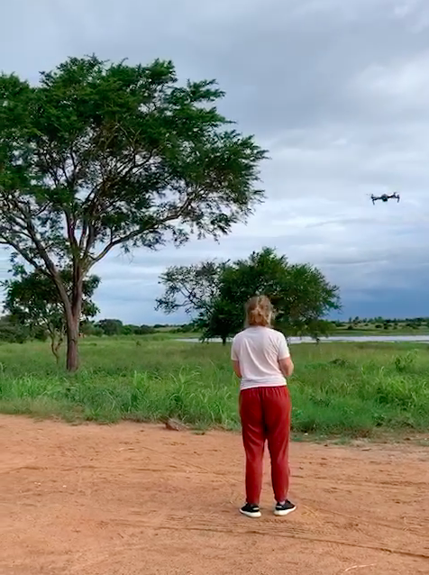
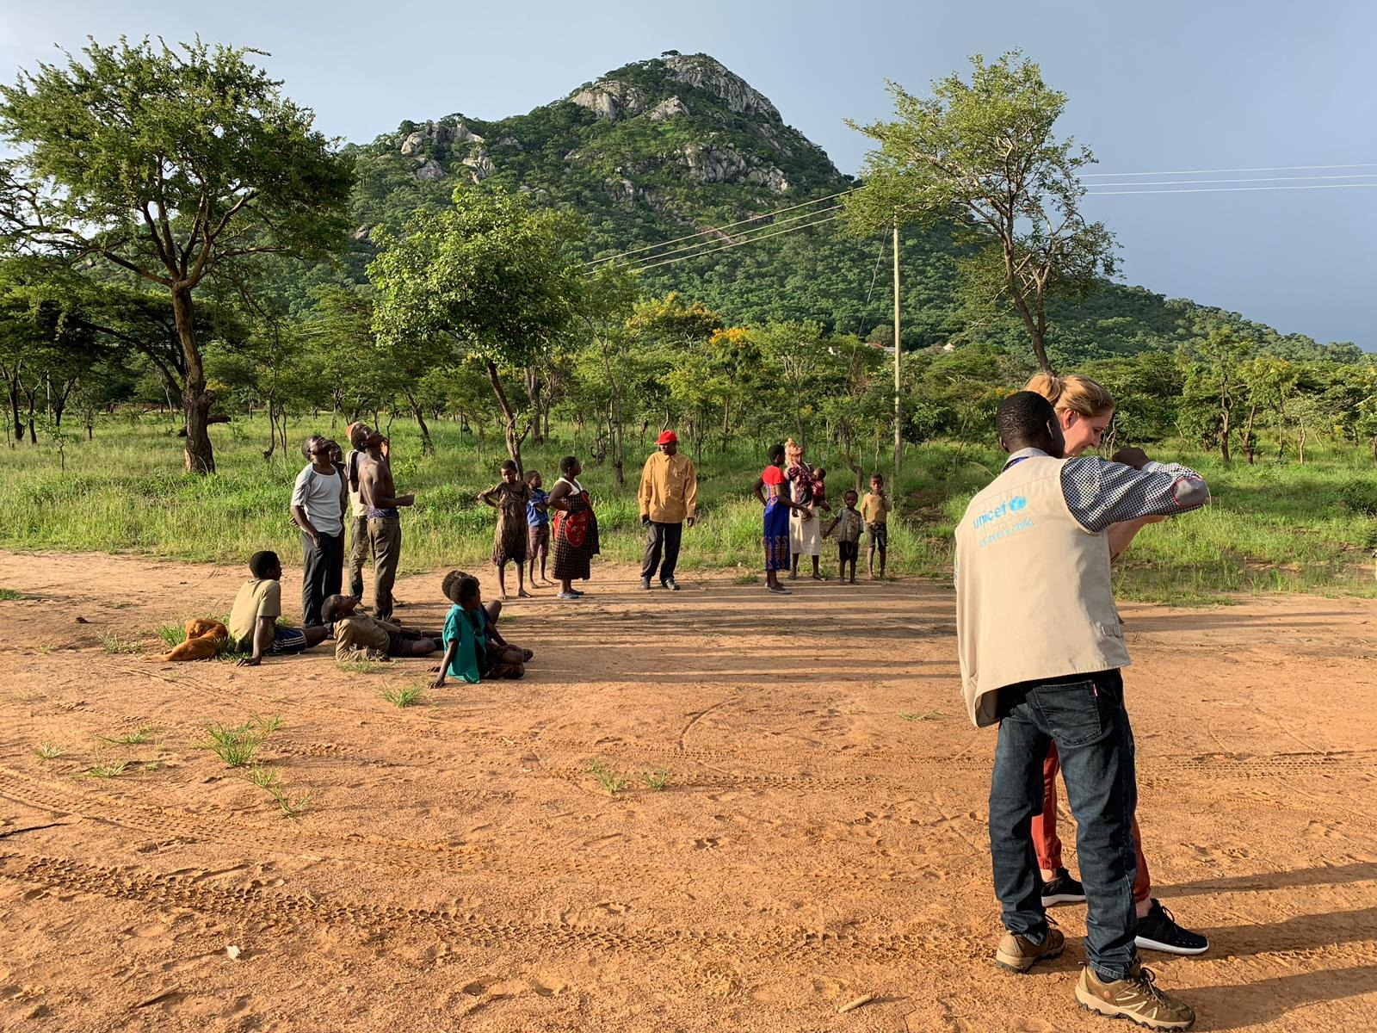
Preventing malaria
Collecting data to develop algorithms for flood modelling and mosquito breeding site identification
Working with students at Lilongwe University of Agriculture and Natural Resources
UNICEFINNOVATION
@unicefinnovate

Slide 25

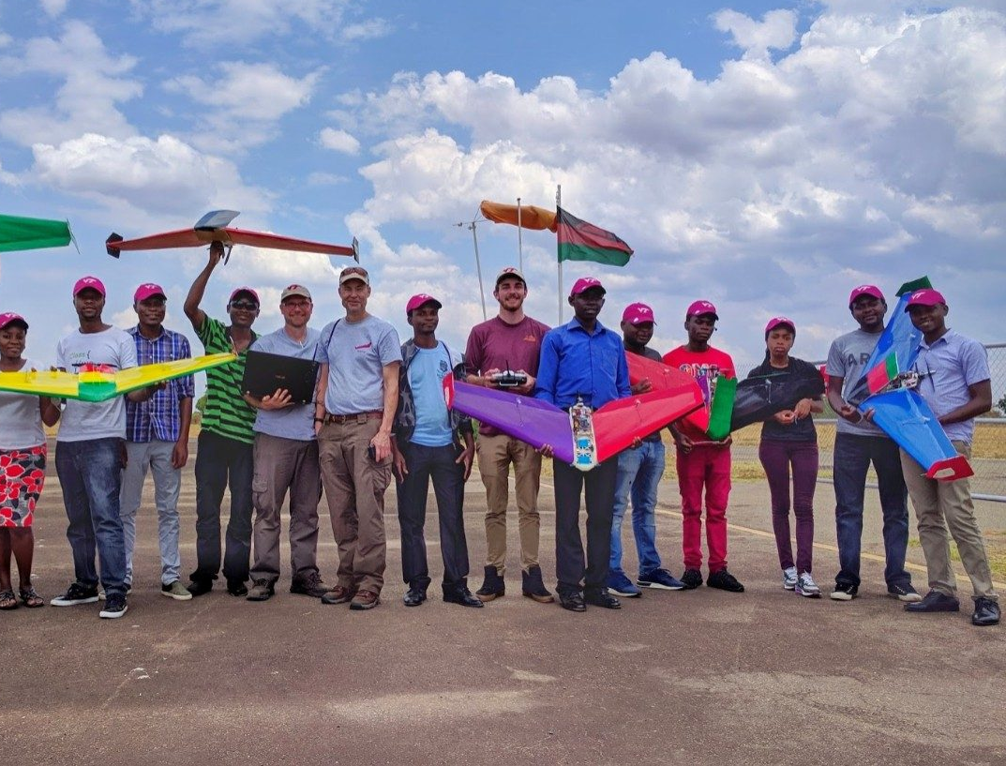
Preparing young African students for jobs in technology
Malawian students building drones for remote medicine delivery.
Develop local skills, stimulate new jobs and entrepreneurship opportunities
The drones completed a 19 km simulated delivery test flight
UNICEFINNOVATION
@unicefinnovate
Notes:
We are proud to be supporting the Government of Malawi, in announcing the first Drone and Data Academy in Africa, next week.
This Academy will be located in the Malawi Drone Corridor, around Kasungu airfield, and provide training in piloting drones, repairing them, and planning for their flights - a set of skills that will be very necessary as these small flying machines become more ubiquitous in delivering supplies or reacting to emergencies.
Companies in Africa struggle to find qualified employees that will be able to support long-term drone operation and data analytical services. The academy will create a pipeline of qualified youth ready to step into a new economy created by drones.
The ADDA will create a pipeline of qualified employees ready to step into a new economy created by unmanned aircraft. The ADDA will be developed and operated by academic institutions with international and local experience, and will offer three distinct programs:
A Remotely Piloted Aircraft Operator’s Certificate, which will be a 1-week intensive course designed to allow drone operators to comply with the certification requirements of civil aviation authorities for drone flight.
Graduates from this program will receive Level 1 certification, which allows them to conduct flight operations. This might vary according to each country’s specific regulations.
A Certificate of Drone Technology, which will be a 11-week program that will cover drone basics, logistics and data analytics.
Graduates from this program will receive Trusted Operator Program Level 2 certification, which qualifies them to operate drones commercially.
A Master’s Program in Drone Innovation, which will be a 24-month master’s degree program that will prepare young students for careers in drone data analysis as well as operations serving the agricultural, natural resources, urban planning, and delivery business sectors.
The graduates from this program will have the skills to compete for jobs using drone applications ranging from agriculture and natural resource monitoring, to data analytics for social and environmental monitoring and prediction.
This academic program will qualify graduates as leaders in the industry, focused on African use cases.

Slide 26
Vanuatu

Slide 27
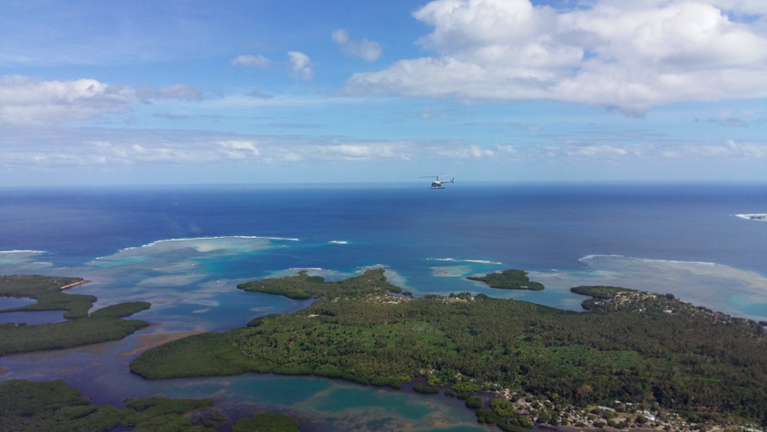
Vanuatu
Population >270,000 (2016)
Children <5 yo: 35,000 (~13% of total population)
Children <1 yo: 8,500 (~3% of total population)
20% of Vanuatu’s children miss out life-saving vaccines
Intense volcanic activity in the archipelago
UNICEFINNOVATION
@unicefinnovate

Slide 28
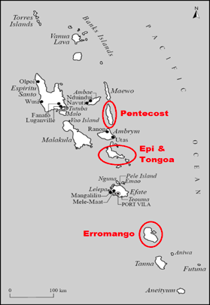
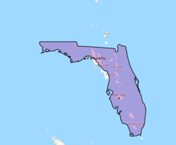
Vanuatu’s geography
Archipelago formed by 83 small islands of volcanic origin.
Runs 1,600 kilometers north to south
65 islands are inhabited
Only 20 have airfields or roads
Many islands are only accessible by boat, the road network is incomplete or inexistent.
UNICEFINNOVATION
@unicefinnovate

Slide 29
Vanuatu
CAAV new regulation for UAVs in Vanuatu
New Zealand - CAA Part 101 & 102
Applied by Vanuatu CAAV & tested during UNICEF’s trials
Results from UNICEF’s trials
Context
Consultations
Australia - CASA Part 101
UNICEF experience from Malawi
2018
2019
UNICEFINNOVATION
@unicefinnovate

Slide 30
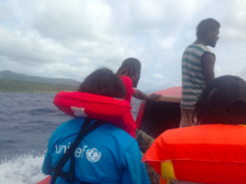
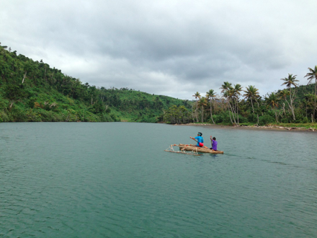
Vaccine delivery international competition
COLD CHAIN Transport of Vaccines & Medical supplies to remote health facilities
Is the industry ready to provide:
A reliable cargo delivery service?
Safely integrated within national airspace?
Acceptable to the local communities?
UNICEFINNOVATION
@unicefinnovate

Slide 31
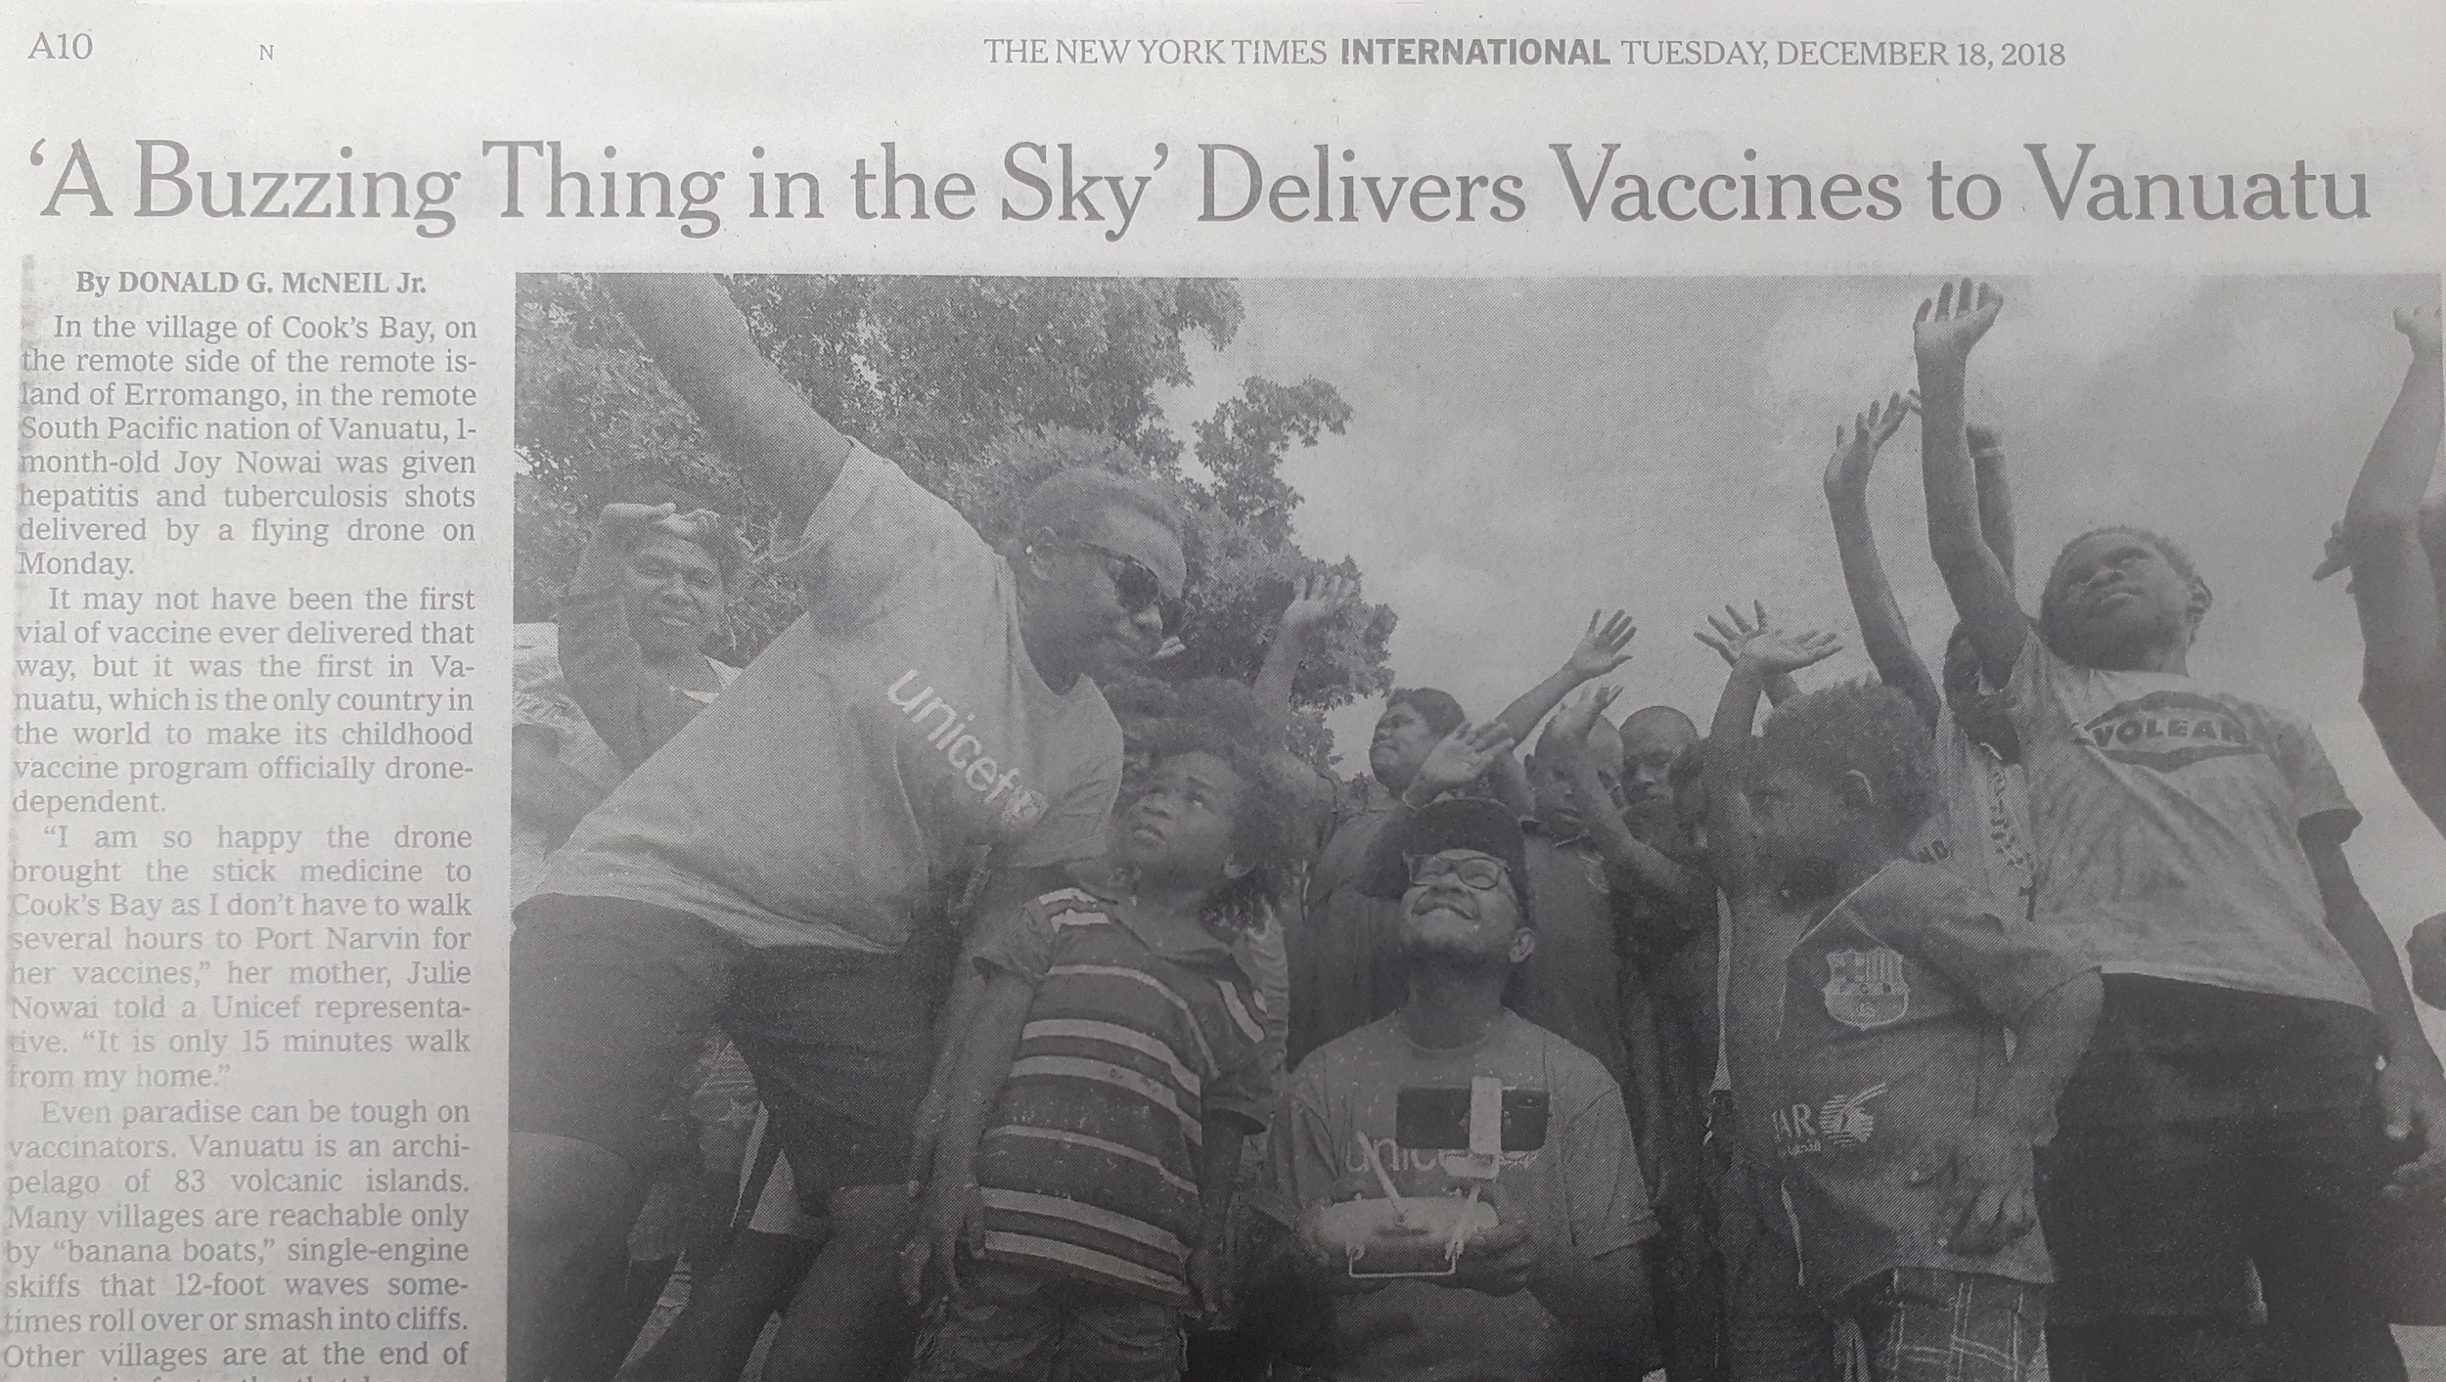
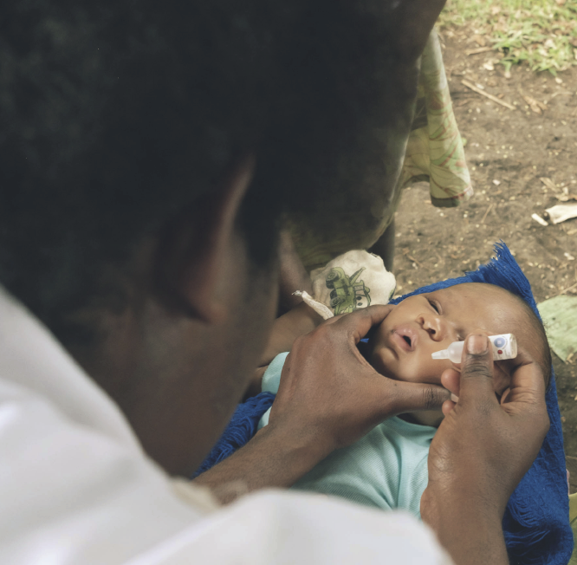
“Today’s small flight by drone is a big leap for global health”*
First child to be given a vaccine delivered commercially by a drone
Drone covered +40 km of rugged mountainous terrain
* Henrietta H. Fore, UNICEF Executive Director
UNICEFINNOVATION
@unicefinnovate

Slide 32
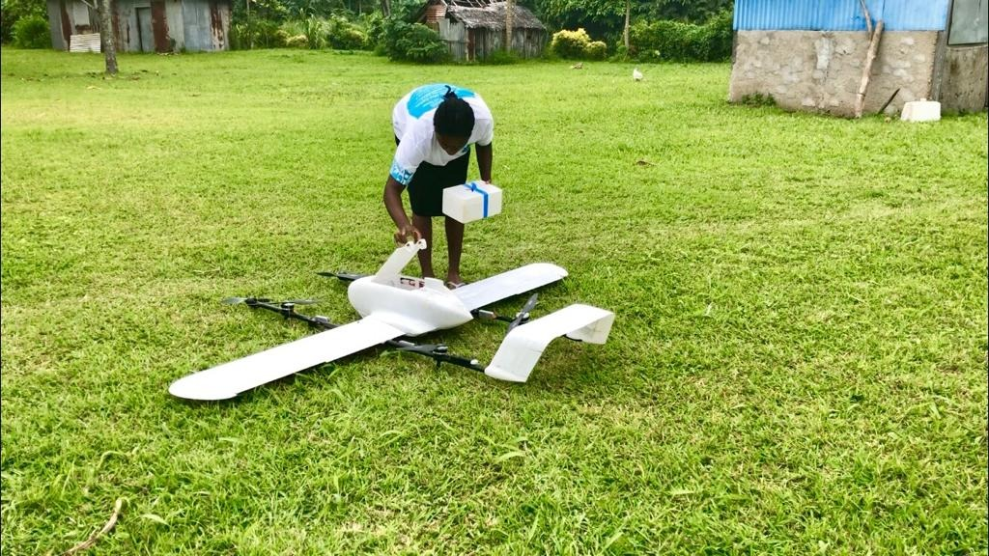

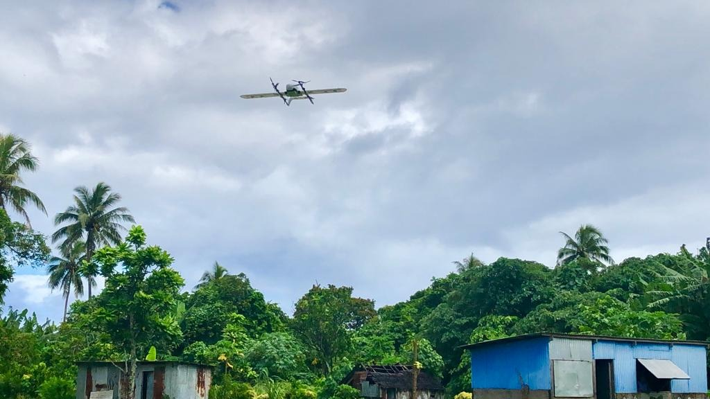
One month on and...
February 26, 2019
Roslynda receives an urgent call and sends Primacine (malaria) and Ventoline (asthma) with the touch of a button
UNICEFINNOVATION
@unicefinnovate

Slide 33
Kazakhstan

Slide 34

Kazakhstan
Population >18 million (2017)
Extreme weather conditions exacerbated by climate change (winds, seasonal flooding).
Seismic activity, remote and mountainous terrain.
UNICEFINNOVATION
@unicefinnovate

Slide 35
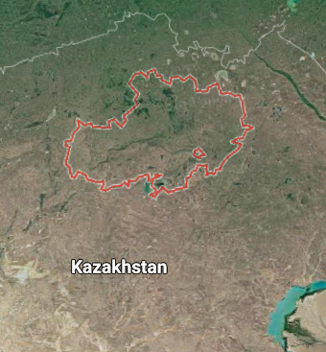
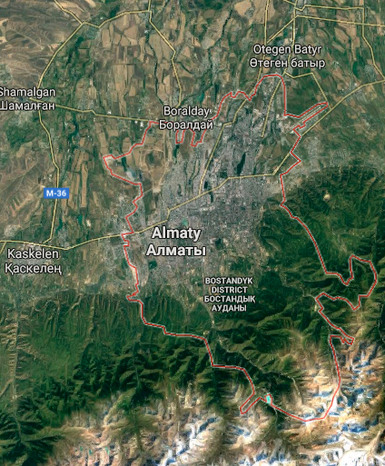
Kazakhstan’s corridors
North:
Akmola province, 100 km length and 50 km width, maximum vertical elevation: 5000 m.
South:
Almaty province, maximum vertical elevation: 3000 m.
UNICEFINNOVATION
@unicefinnovate

Slide 36
Kazakhstan
UNICEF experiences from Malawi & Vanuatu
Inputs for regulatory process
Kazakhstan - Aviation committee
Law 339-IV
Kazakhstan - Amendment Oct. 2017
Kazakhstan - Govt. Decision #506
2 UNICEF drone corridors
Context
Lessons
2010
2011
2017
2018
2019
UNICEFINNOVATION
@unicefinnovate

Slide 37
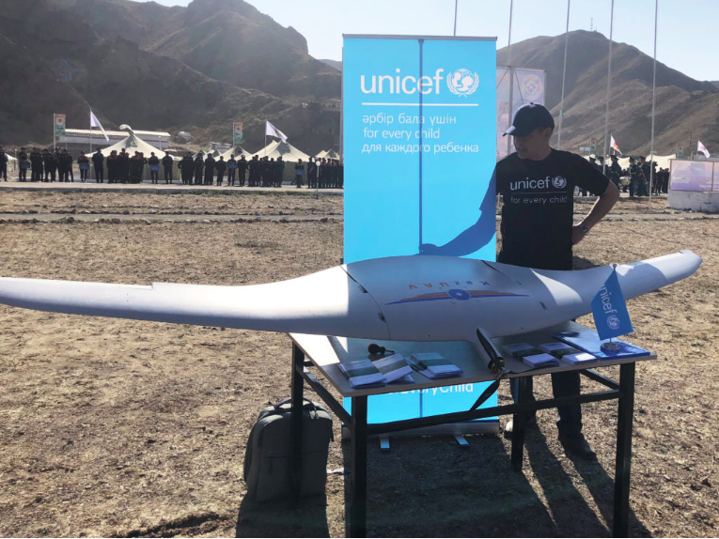
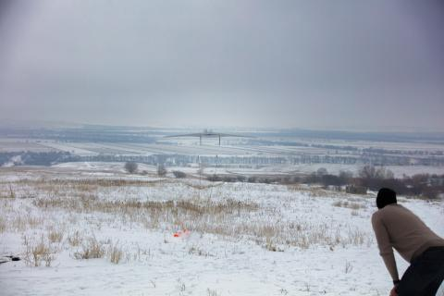
UAVs for disaster risk assessment
Mapping for disaster preparedness in extreme weather conditions
Assess the use of UAS in real-life search and rescue scenarios
UNICEFINNOVATION
@unicefinnovate

Slide 38
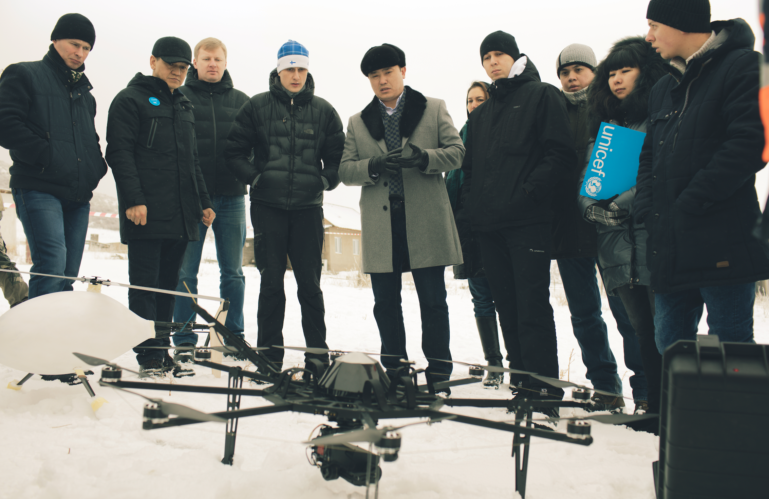
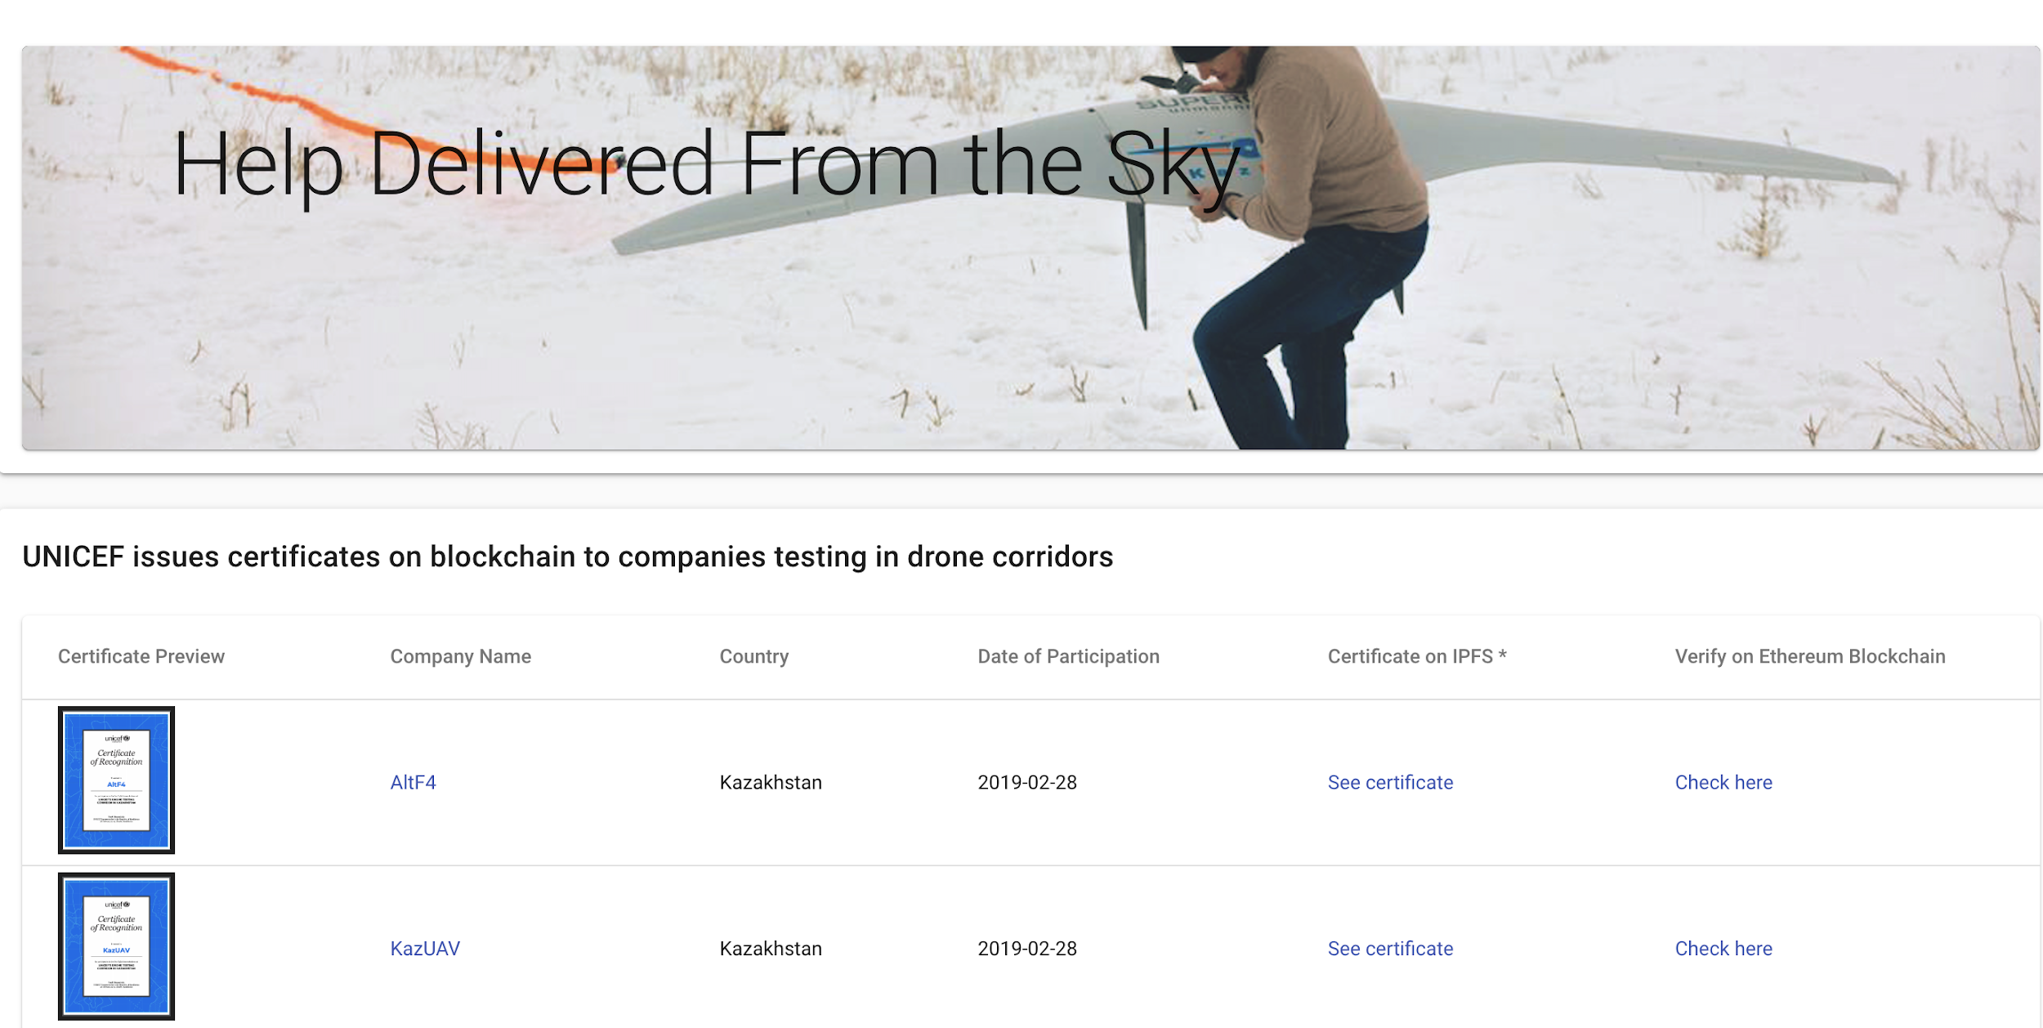
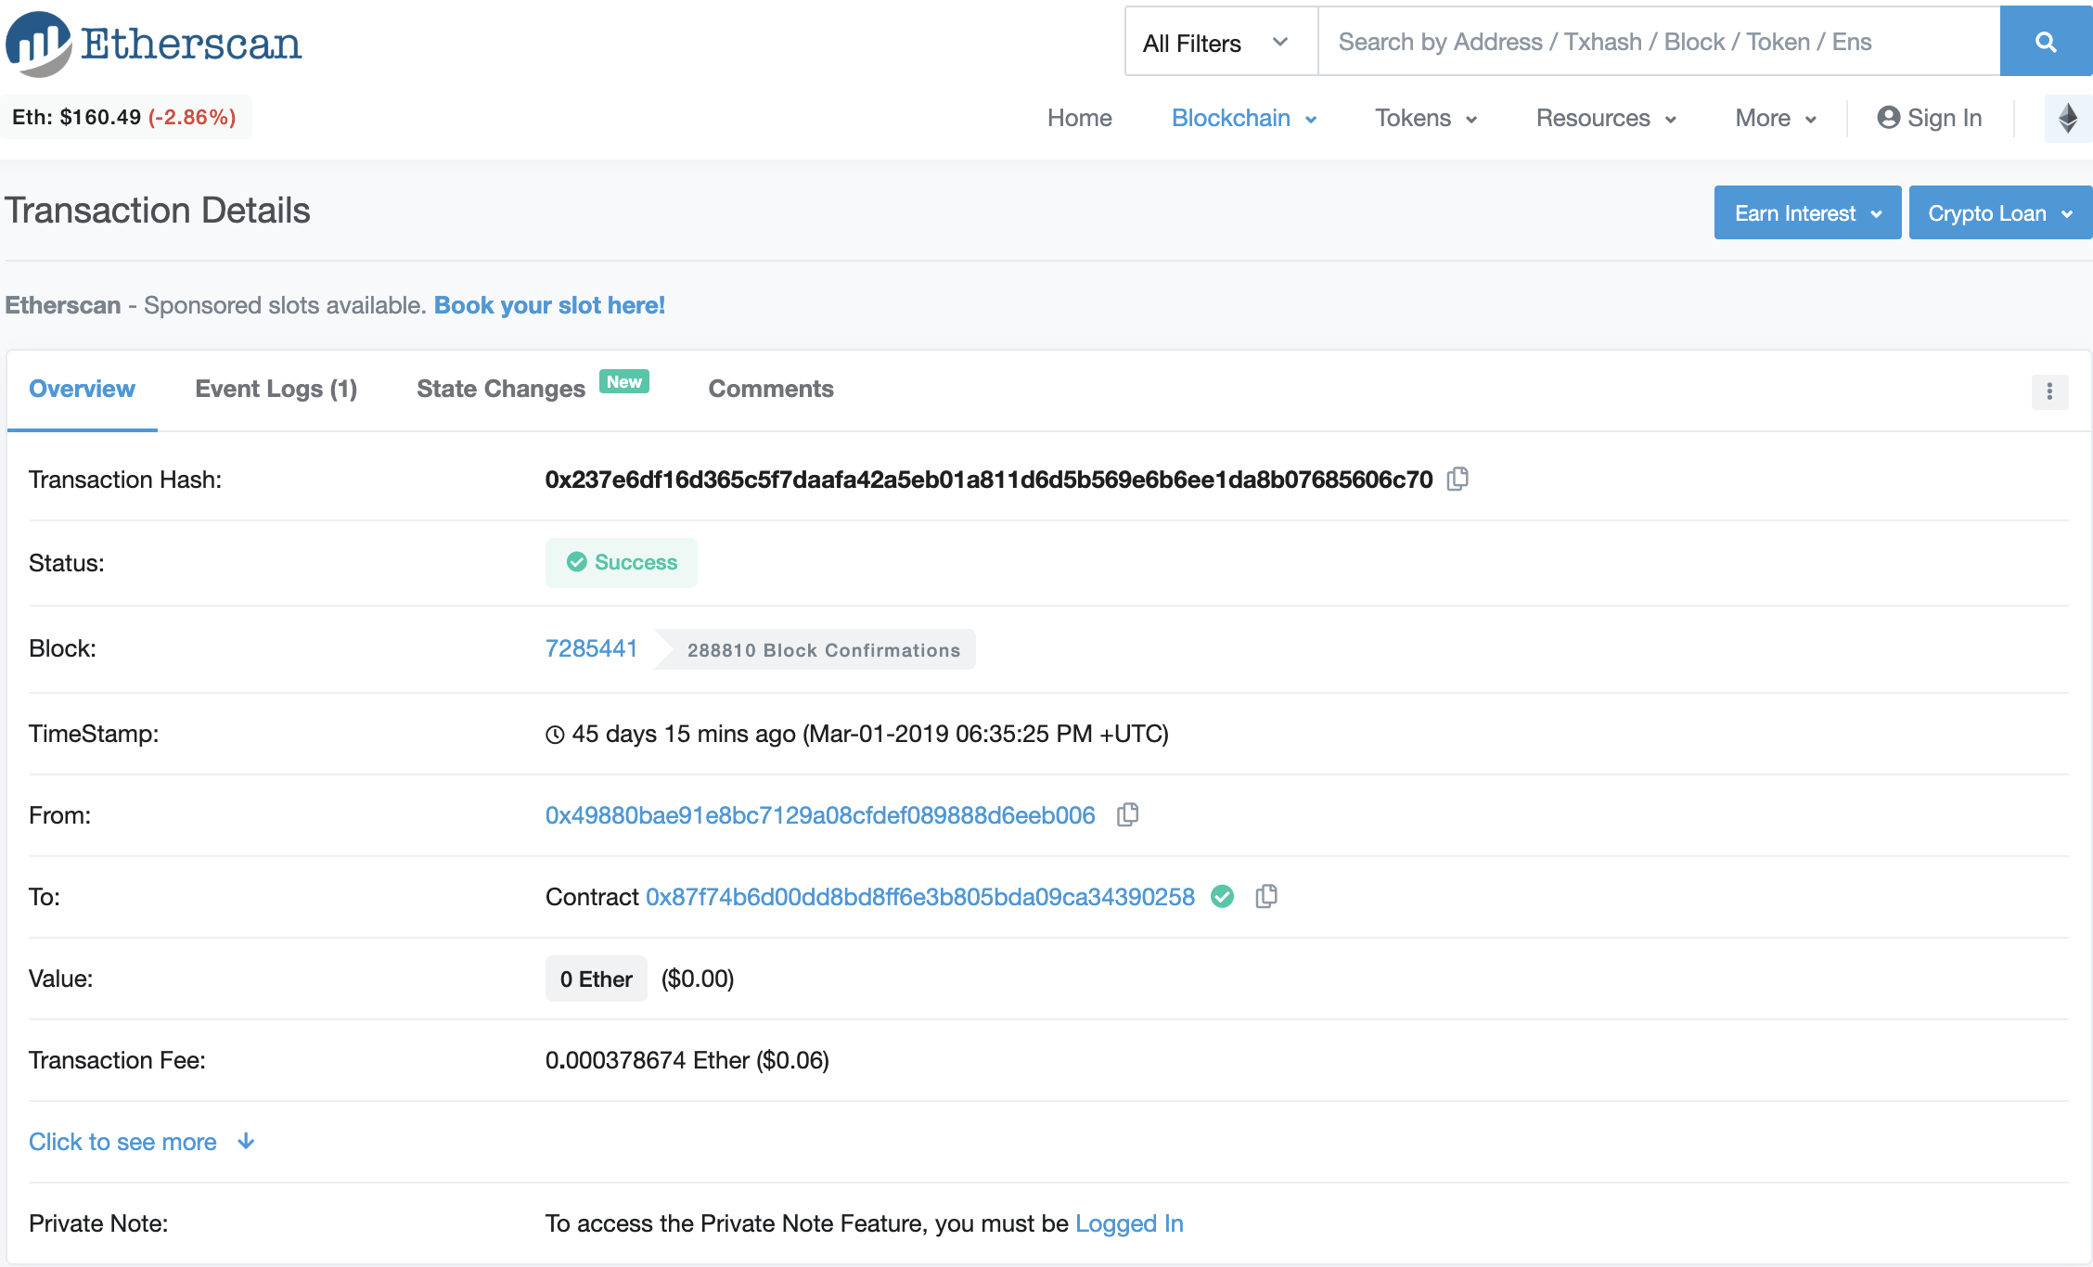
Drone certifications in Kazakhstan
Drone accomplishments are recorded on an immutable blockchain
http://certificates.dignity.network/)
UNICEFINNOVATION
@unicefinnovate
Notes:
And these young people will need portable, cross-border certifications, since jobs will not be limited to or exclusive to any one country.
In our Kazakhstan Corridor we are already experimenting with blockchain-based certification of flights - allowing for individual and private ownership of an immutable record of skills and achievement that can be used in other locations.

Slide 39
Final reflections
Drone corridors as an accelerator:
From experimentation areas to a sandbox for UNICEF, partners and CAA to ensure providers are technically, operationally and logistically ready to conduct flights.
Hubs for learning about UAS technology and regulations: A safe space for governments to test services, regulatory frameworks, and create opportunities for knowledge transfer.
Build local capacity: Skills for operators + (transnational) certifications.
UNICEFINNOVATION
@unicefinnovate
Notes:
Scott Dubin, Chemonics: “The drone corridor made all the difference.” UNICEF’s investment and partnership in drones for humanitarian response laid the groundwork for USAID’s project and has made Malawi a hotbed for innovation and data work, enabling organizations to come in and scale-up their pilot projects.

Slide 40
Final reflections
Business ecosystem:
Seed funding from UNICEF Venture Fund to jump start drones for good local businesses.
Supply chain:
Maximize flights / flight time, drive down fixed costs, layer multiple use cases.
Work with logistics management companies
UNICEFINNOVATION
@unicefinnovate
Notes:
Scott Dubin, Chemonics: “The drone corridor made all the difference.” UNICEF’s investment and partnership in drones for humanitarian response laid the groundwork for USAID’s project and has made Malawi a hotbed for innovation and data work, enabling organizations to come in and scale-up their pilot projects.

Slide 41
Jaime Archundia (@JaimeArchM)
Drone Lead, UNICEF Innovation
jarchundia@unicef.org
@unicefinnovate
Notes:
To support this process, UNICEF can help host countries with:
previous experiences on how other countries have enabled regulatory frameworks for the use of drones in humanitarian and development missions;
the implementation of drone corridors to test technologies, services and regulatory frameworks, and build partnerships to accelerate the development of drones for good use cases;
seed funding from UNICEF Innovation Fund to jump-start local drones for good businesses;
actionable insights to develop an optimized supply chain scheme to drive down the fixed costs of using drones;
a scalable and self-sustainable educational program to create local capacity, such as the African Drone and Data Academy (ADDA) that will be implemented in Malawi, as well as a pathway to the development of transnational drone operator certifications;
a data management strategy for drone acquired imagery (especially for data collection and analysis during an emergency response);
the development of toolkits to use drones in emergencies and specialized teams capable of operating drones for emergency response (DroneCorps); and
the use of a UAS Traffic Management System (UTM) to increase safety of BVLOS drone operations in close cooperation with Air Traffic Management.

